Slide 1
20cm 可視光望遠鏡 CMOS カメラの性能評価
著 者：今井 優理、細川 稜平、村田 勝寛、庭野 聖史、伊藤 尚泰
高松 裕、谷津 陽一、河合 誠之 所 属：東京工業大学
1

Slide 2
目次
イントロ
主なターゲット
望遠鏡開発背景
20 cm 可視光望遠鏡
カメラ：ZWO ASI294MM Pro
評価項目
方法
実験環境
結果と考察
リニアリティ
まとめと今後の展望
2
Notes:
The contents are like this.
First, I will introduce gravitational waves and talk about our telescope project. After that, I will explain the performance evaluation of the camera, which is my research, and the results. Finally, I will conclude with a summary and future prospects.

Slide 3
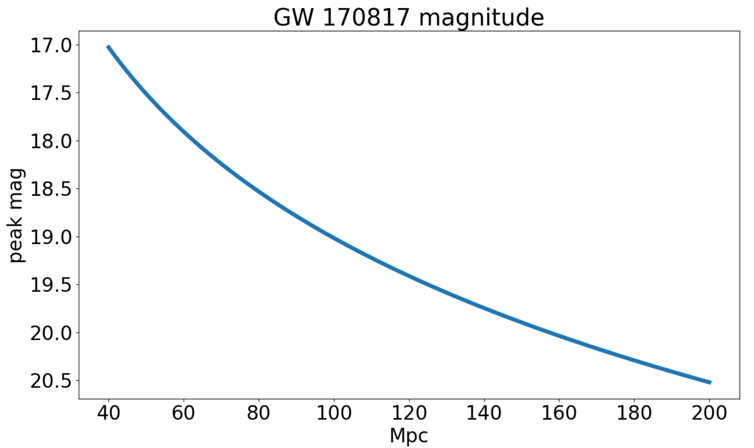
主な観測ターゲット：重力波
GW 170817 magnitude
BNS (~200 Mpc) を主に観測
可視での観測例：GW 170817
誤差領域 30平方度
40 Mpc (NGC4993)
検出直後 17等
17.0
17.5
18.0
18.5
Peak mag
19.0
19.5
20.0
20.5
40
60
80
100
120
140
160
180
200
Mpc
なるべく広い視野
限界等級：17等以上 (なるべく深く)
図1. GW 170817 の期待される等級(可視光)
3
Notes:
So, let's start with the explanation of gravitational waves.
Gravitational wave, in short, GW is a 'ripple' in space-time caused by some of the most violent and energetic processes in the Universe. Albert Einstein predicted the existence of gravitational waves in 1916 in his general theory of relativity.
Only gravitational wave detectors can detect gravitational waves directly.
GW 170817 is the only event of which optical counterpart was observed.
This occurred 40Mpc away from the earth.
This event is believed to be due to the BNS, binary neutron star merger.
The observation of optical counterpart of this event made it almost certain that heavy elements would be synthesized in.

Slide 4
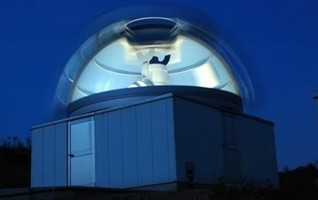
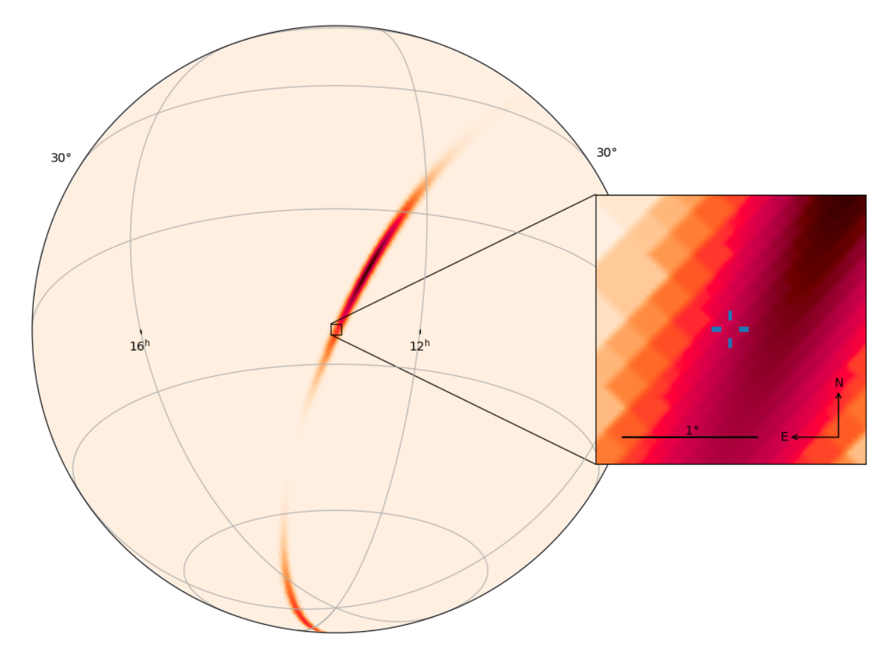
望遠鏡開発背景
新しい望遠鏡を、
より広い視野
限界等級 17等以上 (なるべく深く)
低予算
で開発したい
図2. MITSuME望遠鏡 (岡山)
MITSuME の視野：
28’ × 28’
1°
4
図3. GW 170817 の誤差領域とMITSuMEの視野
Notes:
So, let's start with the explanation of gravitational waves.
Gravitational wave, in short, GW is a 'ripple' in space-time caused by some of the most violent and energetic processes in the Universe. Albert Einstein predicted the existence of gravitational waves in 1916 in his general theory of relativity.
Only gravitational wave detectors can detect gravitational waves directly.
GW 170817 is the only event of which optical counterpart was observed.
This occurred 40Mpc away from the earth.
This event is believed to be due to the BNS, binary neutron star merger.
The observation of optical counterpart of this event made it almost certain that heavy elements would be synthesized in.

Slide 5
20 cm 可視光望遠鏡
ZWO
ASI294MM PRO
- CMOS カメラ
可視光
FOV：2.7$°×$1.8$°$
限界等級：19 mag
(gバンド、SN=5、1000s)
可搬性
低価格
アマチュア天文用
拡張性
CELESTRON
RASA 8
- 口径: 20 cm
5
図4. 望遠鏡の外観
Notes:
So, we are developing a new optical telescope satisfying such requirements.
It consist of a CMOS camera called ASI 294MM Pro from ZWO and a 20 cm diameter lens barrel called RASA8.
This telescope’s field of view is 2.7 ° x 1.8 ° .
A further notable feature is the low price because these instruments are for amateur astronomers, not for science purpose.
Therefore, we need to check whether these instruments can be used for science.

Slide 6
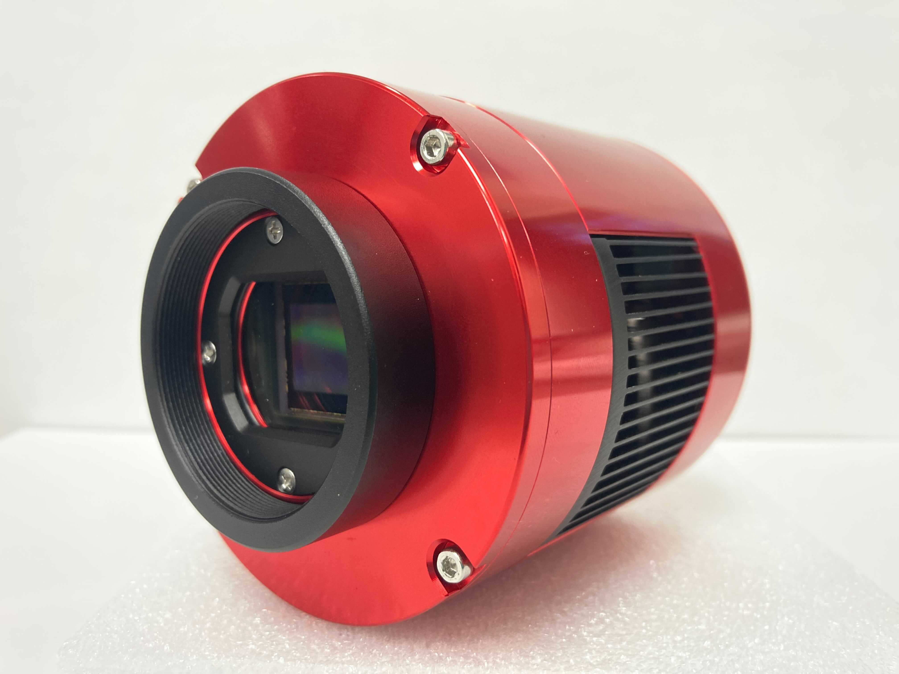
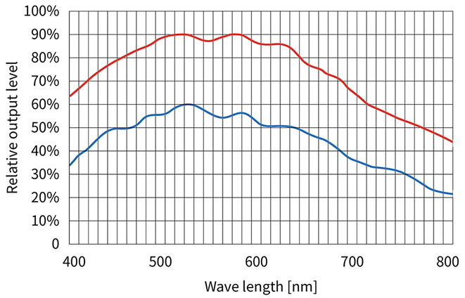
カメラ：ZWO ASI294MM Pro
― ASI294MM Pro
― ASI1600MM Pro
図5. ASI294MM Pro
低価格
高い量子効率
イメージエリア: 19.2 mm * 13 mm
図6. 量子効率
https://www.kyoei-osaka.jp/SHOP/zwo-asi294mm-pro.html
8
Notes:
This is the camera that we are evaluating.
The feature of this camera is low price, High quantum efficiency, and large image area.
This camera has high quantum efficiency in the optical wavelength band.

Slide 7
評価項目
リニアリティ
ノイズ評価
量子効率
時刻精度
露光時間の管理精度
7
Notes:
There are five main performance requirements for this camera.
Linearity for EXPOSURE TIME vs COUNT
Amount of various noise
High quantum efficiency
Camera time accuracy
and
Exposure time control accuracy.
Currently, I am investigating the top two of these.

Slide 8
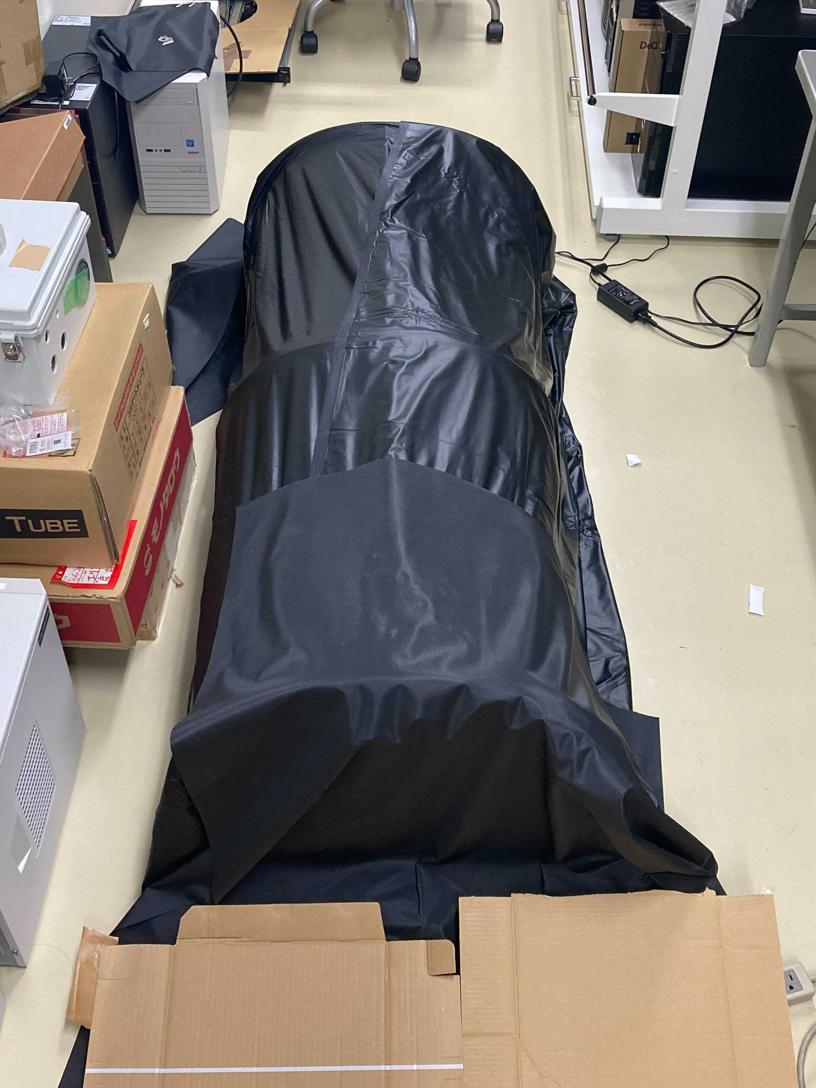
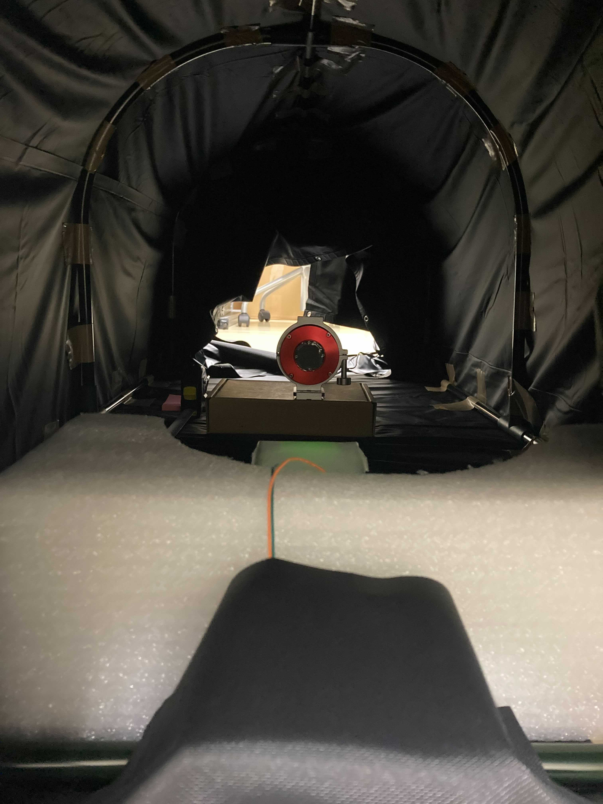
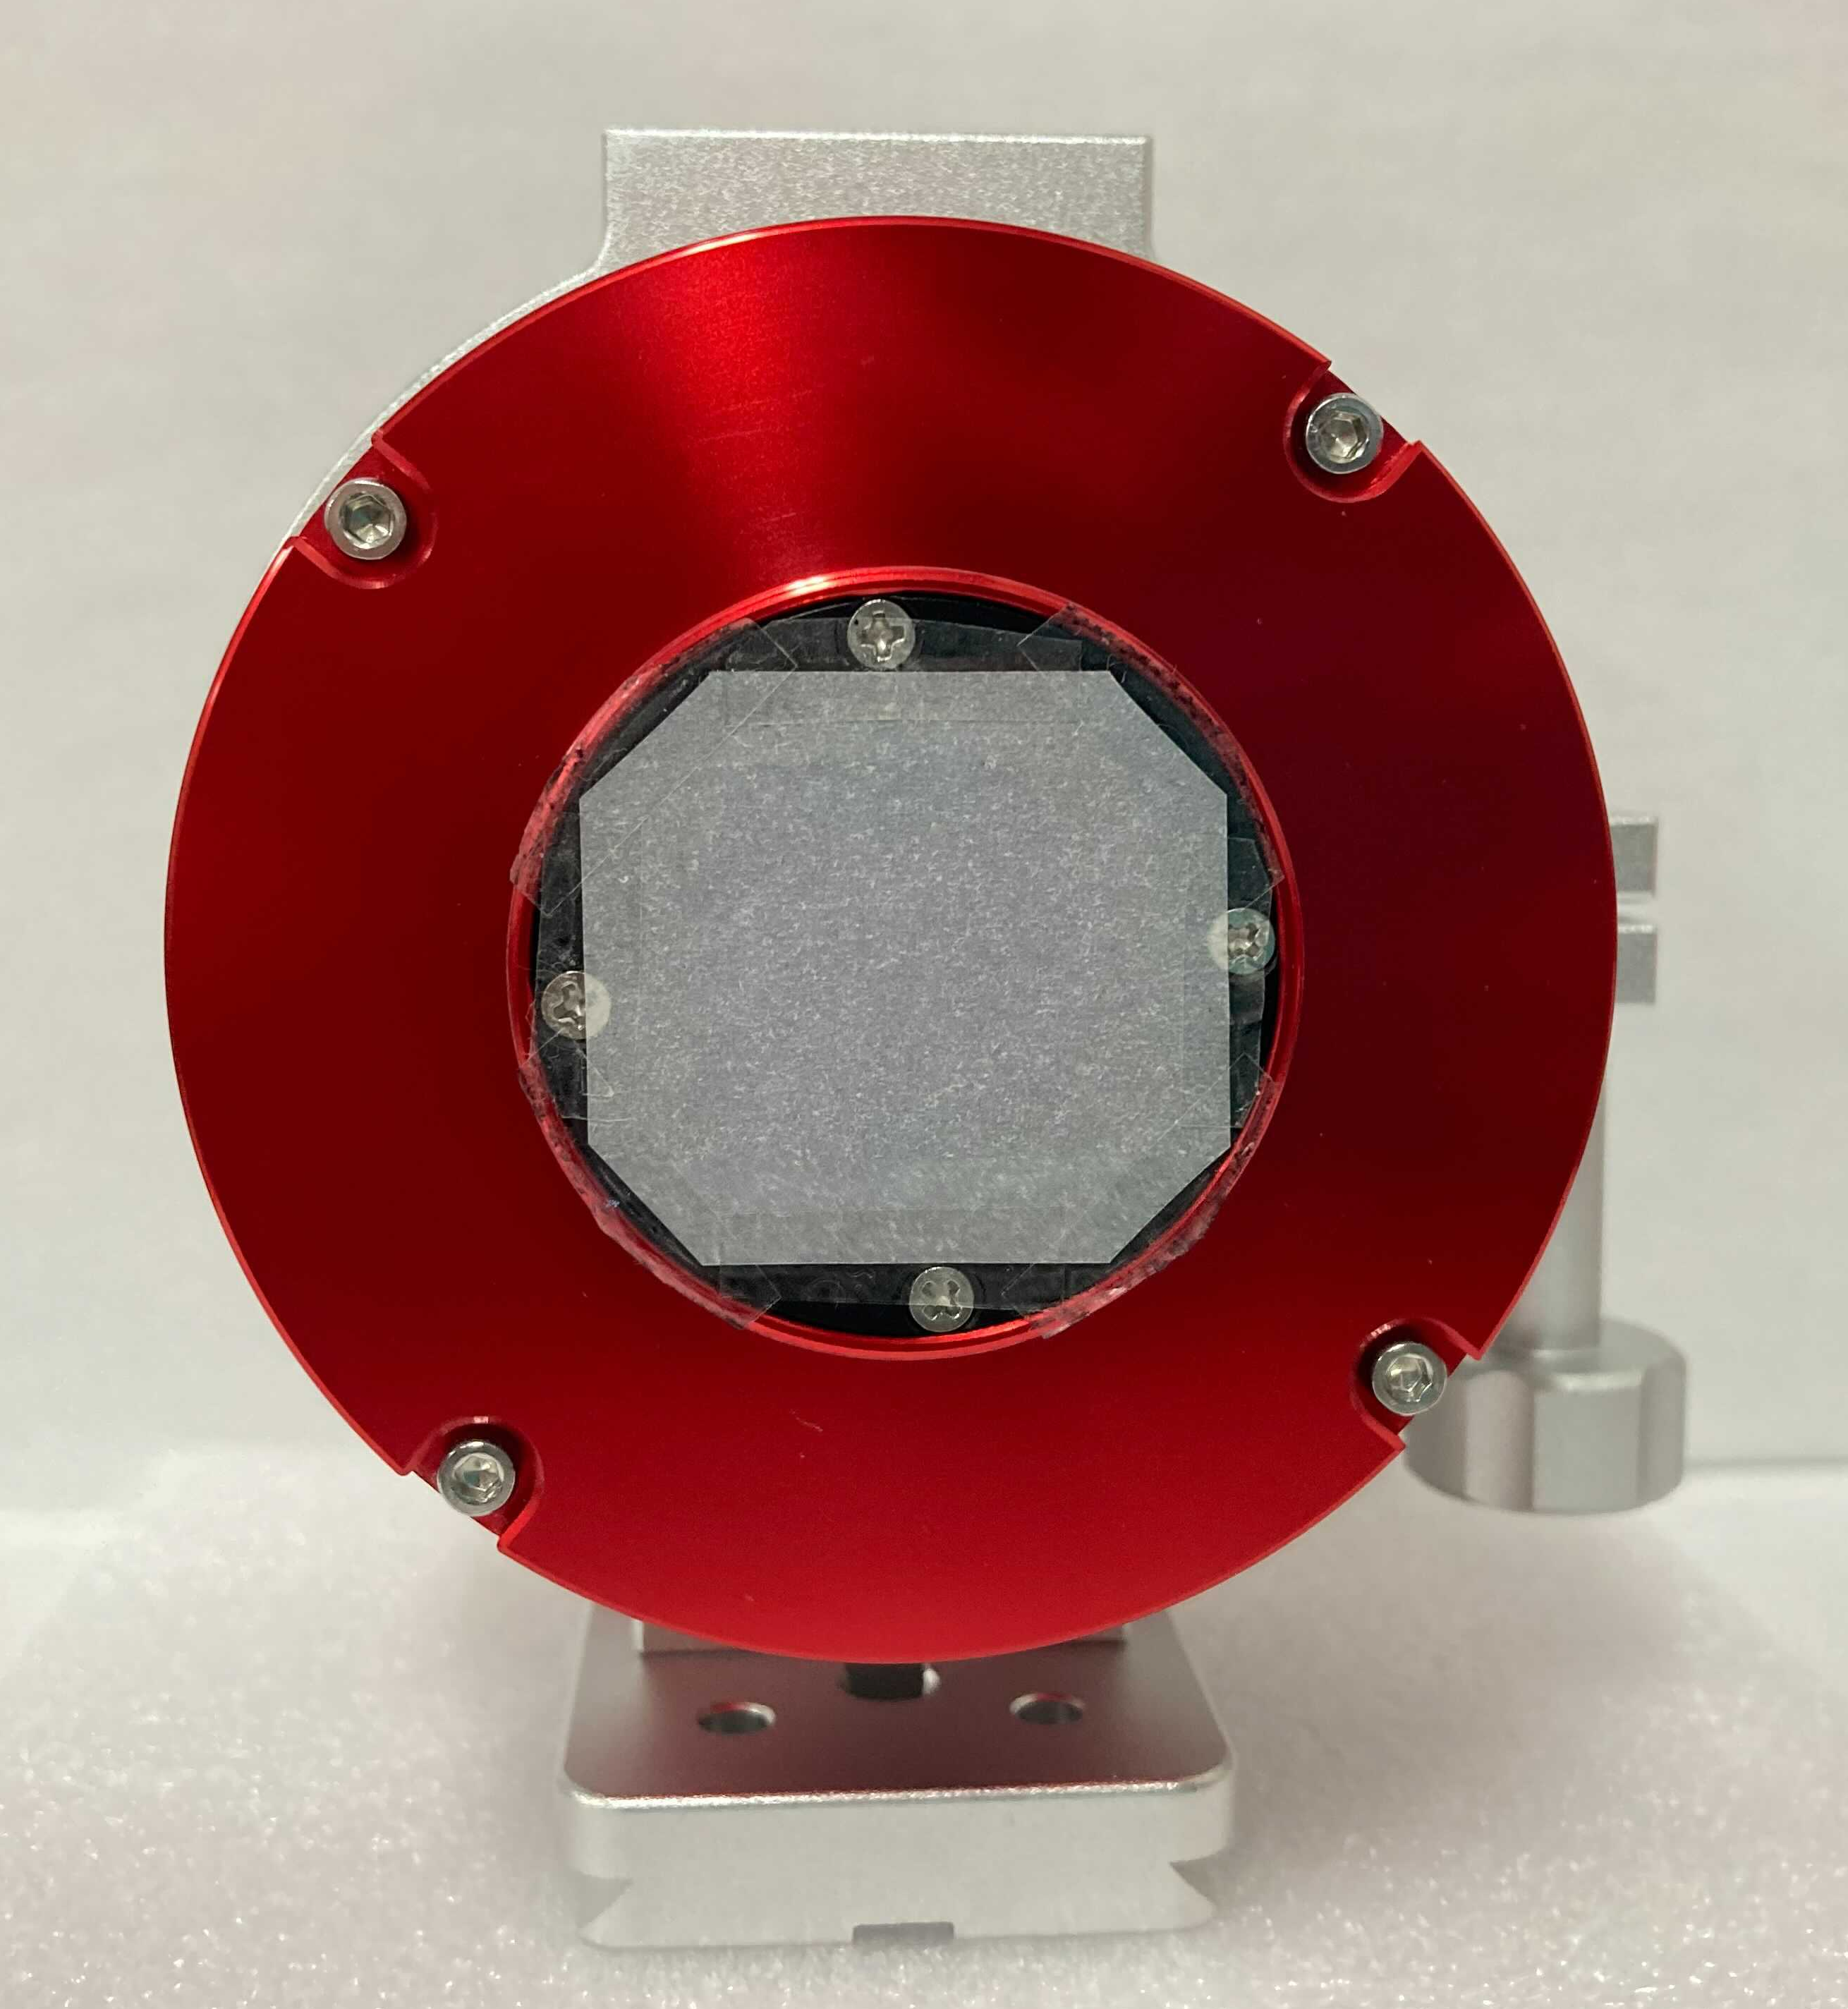
実験環境
トレーシング
ペーパー
カメラホルダー
コピー用紙
LED (可視光)
図7. 実験環境
8
Notes:
This is the experimental environment.
We made a darkroom and put camera and LED in it like this.

Slide 9
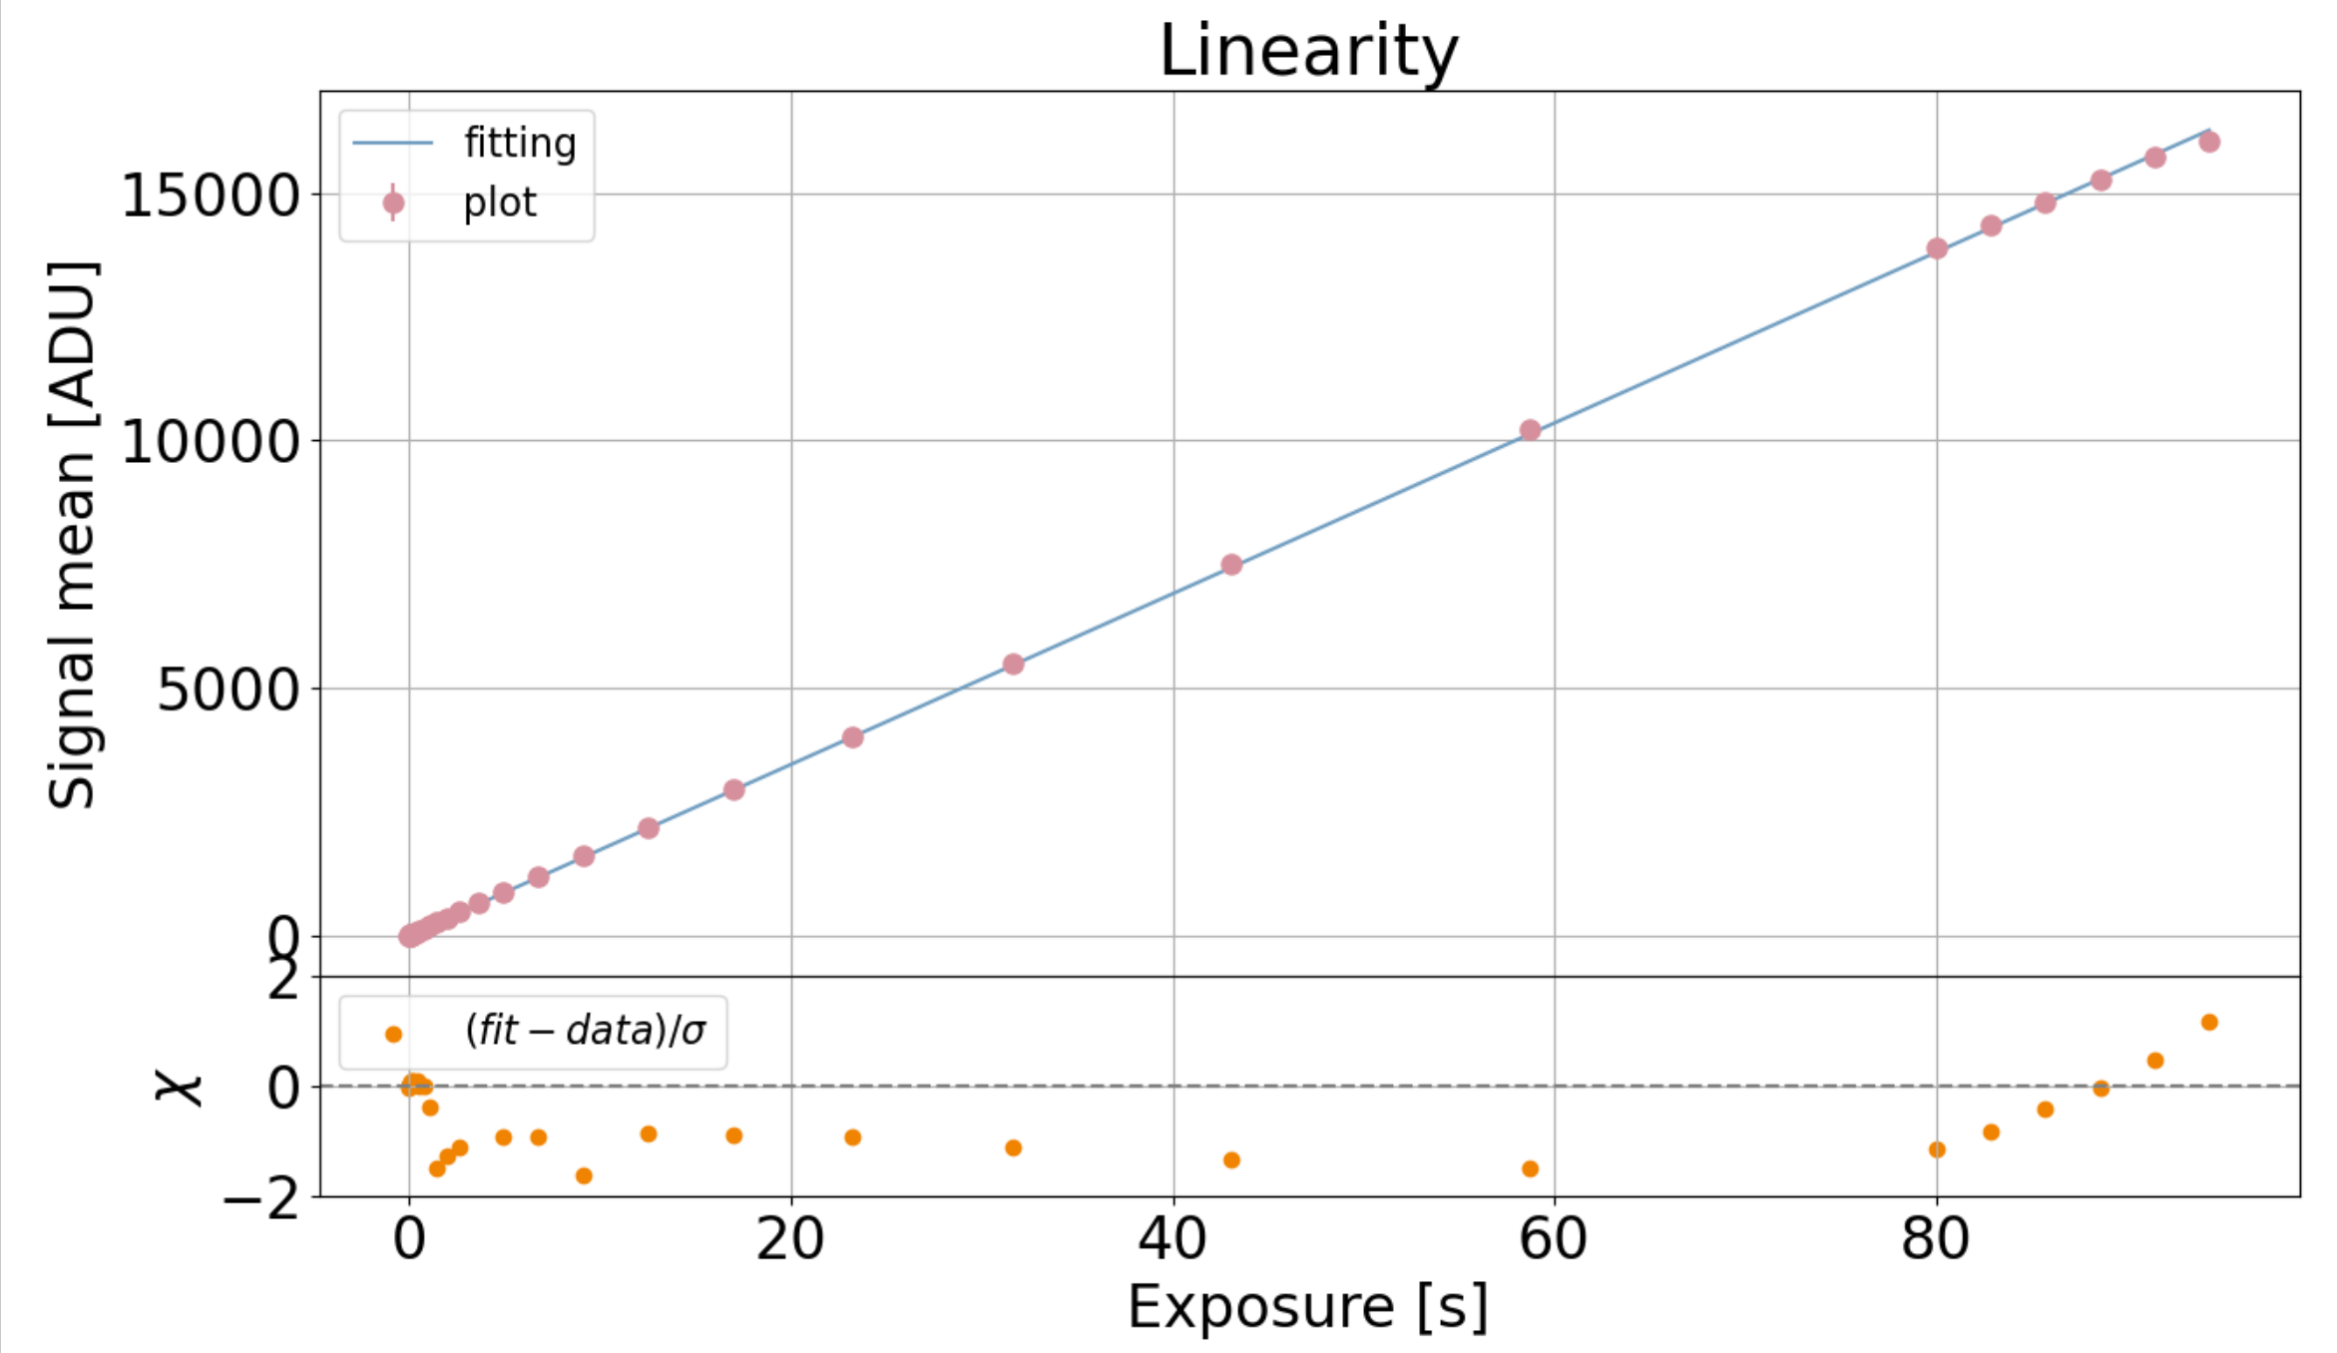
リニアリティ
パラメータ
Gain = 0
Bias = 1
露光時間：0.001 s ~ 120 s
CMOSの温度：0 ℃
図8. リニアリティ
9
Notes:
First, we checked the linearity of this sensor.
In this figure, x-axis indicates exposure time and in upper panel, y-axis indicates mean of signal.
The pink point is data and blue line is fitted line of the data.
In lower panel, residual of them are plotted.
Since all residuals are within 2 sigma error, it can be said that the linearity is well in all range.
-10, 0でかいてみる
→重なるようなら、0のみで、-10でも同じことやりました、と言う
よくfittingできています＆リミットはここです

Slide 10
まとめと今後の展望
まとめ
~200Mpc の BNS を観測したい
可視光広視野望遠鏡を作成
FOV：2.7$°×$1.8$°$
限界等級：19 mag (gバンド、SN=5、1000s)
可搬性、低価格、拡張性
今後の展望
Gainを変えて解析、他の評価項目の評価
g, zバンドでの観測
この後岡山に設置
10
Notes:
Summaryはこれだけでいったん締める。これまでに出てきていない未来の目標はfuture workとして別途口頭説明
Summary
Gain、温度を変えて実験する
Future work
Other requirementsについても調べる
実際にとった星の写真の解析も同時に進めていきたい

