Slide 1
Astronomical Polarization and ALMA Polarimetry
Hiroshi Nagai
(ALMA Project, NAOJ)

Slide 2
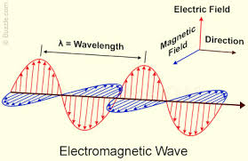
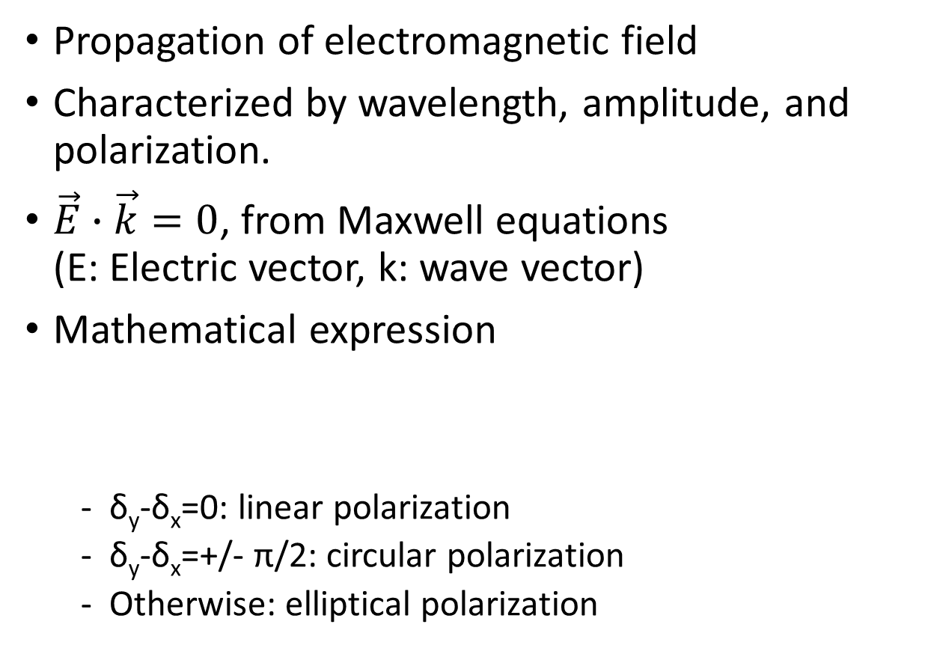
Electromagnetic (EM) Waves
Propagation of electromagnetic field
Characterized by wavelength, amplitude, and polarization.
$\vec{E}∙\vec{k}=0$, from Maxwell equations (E: Electric vector, k: wave vector)
Mathematical expression
δ_{y}-δ_{x}=0: linear polarization
δ_{y}-δ_{x}=+/- π/2: circular polarization
Otherwise: elliptical polarization
Ey
A_{y}
δy-δx>0
A_{x}
Ex
δy-δx<0

Slide 3
EM Waves in practice
EM waves in real world are not monochromatic but a summation of multiple EM wave components.
Thus, only partially or rarely polarized.
Typically, less than few percent for most cases.
Major polarization mechanism in radio astronomy:
Synchrotron radiation
Radiation from dust grain aligned to magnetic field or by radiation field
Scattering
Zeeman effect

Slide 4
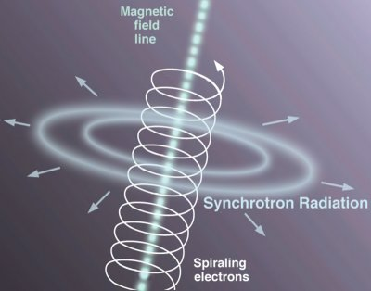
Synchrotron radiation
Interaction between relativistic electron and magnetic field
S_{ν}∝ν^{-α}, thus brighter at lower frequency
Linearly polarized
EVPA ⊥ B
Useful to constrain projected magnetic field direction.

Slide 5
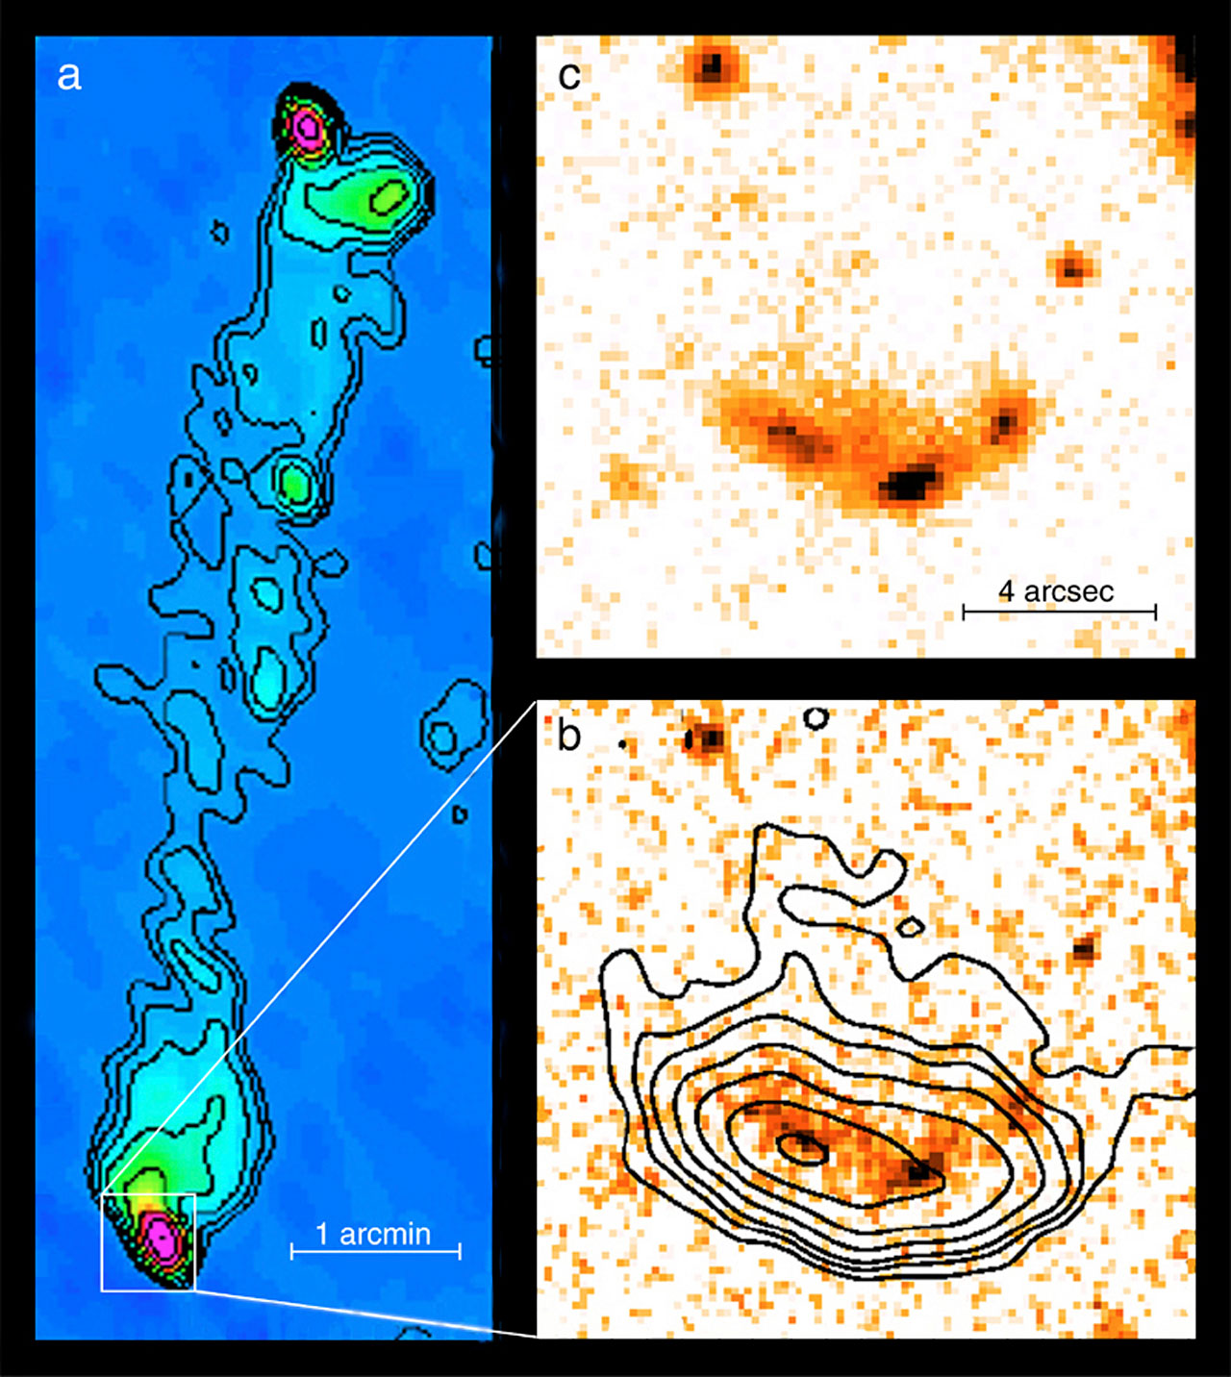
Synchrotron radiation
Orienti+ 2017
Contour: Stokes I
Color: Pol intensity
Vector: EVPA
Contour: Stokes I
Color: Fractional Pol.
Two main spots are strongly polarized and parallel EVPA (perpendicular B-field), indicating strong shocks
Little polarization between two main spots and northern region where the emission is visible up to IR and optical, indicating turbulent acceleration plays a role for the diffuse emission
Prieto+ 2002

Slide 6
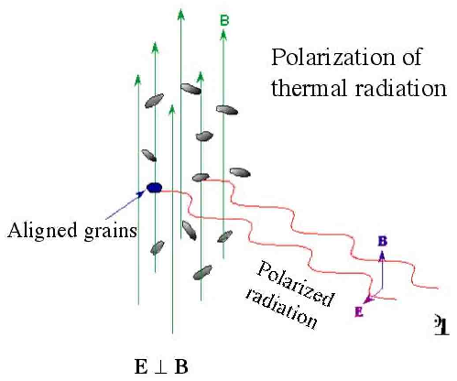
Dust polarization
Thermal radiation from dust grains aligned to B-field (Davis & Greenstein 1951)
Linearly polarized
EVPA ⊥ B
Useful to constrain projected magnetic field direction.
Note that polarization intensity is nothing to do with magnetic field strength.
Similar alignment can be produced by radiative torque (RAT, e.g., Dolginov & Mitrofanov 1976).
Lazarian 2008

Slide 7
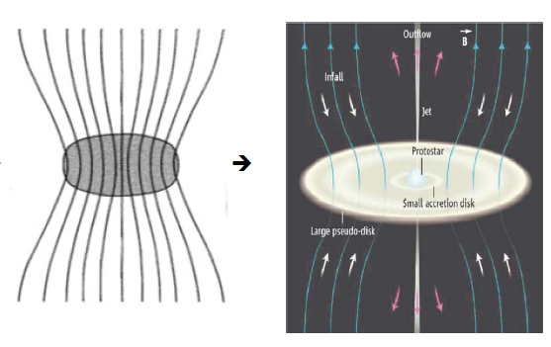
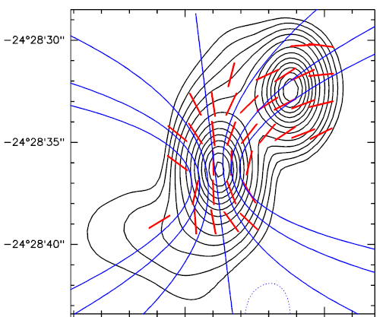
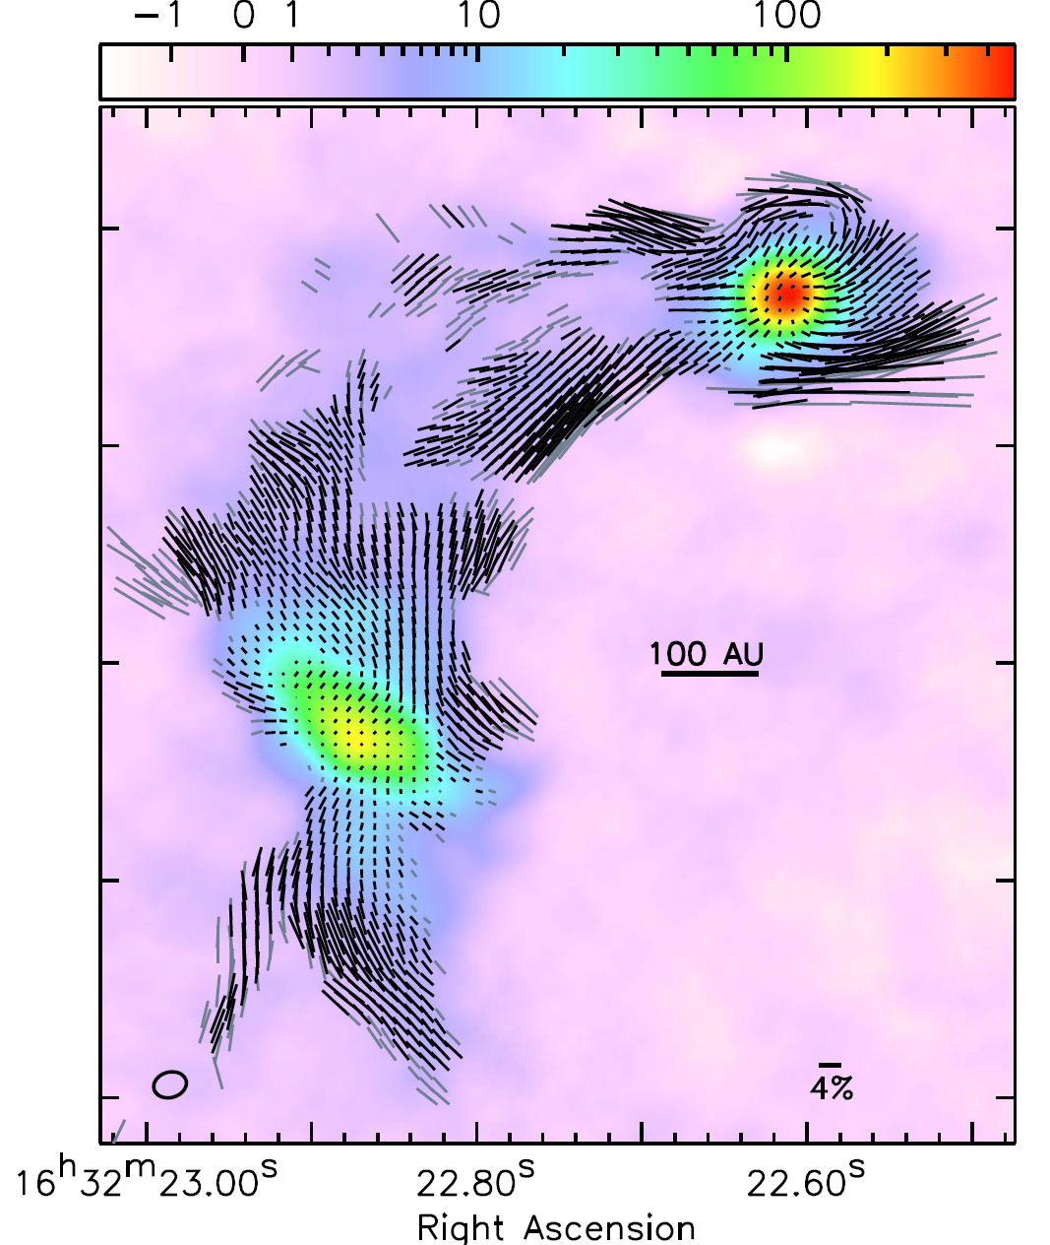
Dust polarization
Rao+ 2000 (SMA observations)
Sadavoy+ 2018 (ALMA Observations)

Slide 8
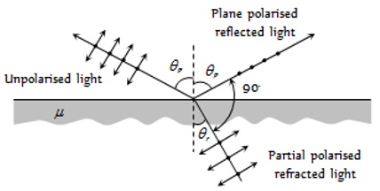
Scattering
Scattering by submm-mm size dust grains becomes dominant in ALMA frequencies.
Linearly polarized
Useful to constrain grain size (theoretical background: Kataoka+ 2015).
NB: no clue for magnetic field
Kataoka+ 2015

Slide 9
Scattering
Kataoka+ 2016
Polarization observation of protoplanetary disk HD 142527.
Polarization vectors are radial in the main ring, while azimuthal in north-east.
The flip of polarization vectors is predicted by the self-scattering of thermal dust emission due to the change of the direction of thermal radiation flux.
HD 142527
azimuthal
radial

Slide 10
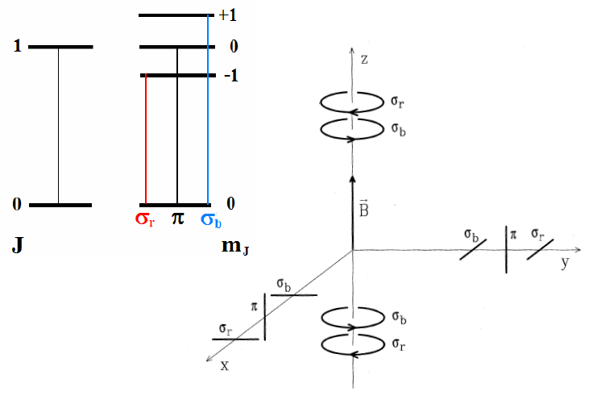
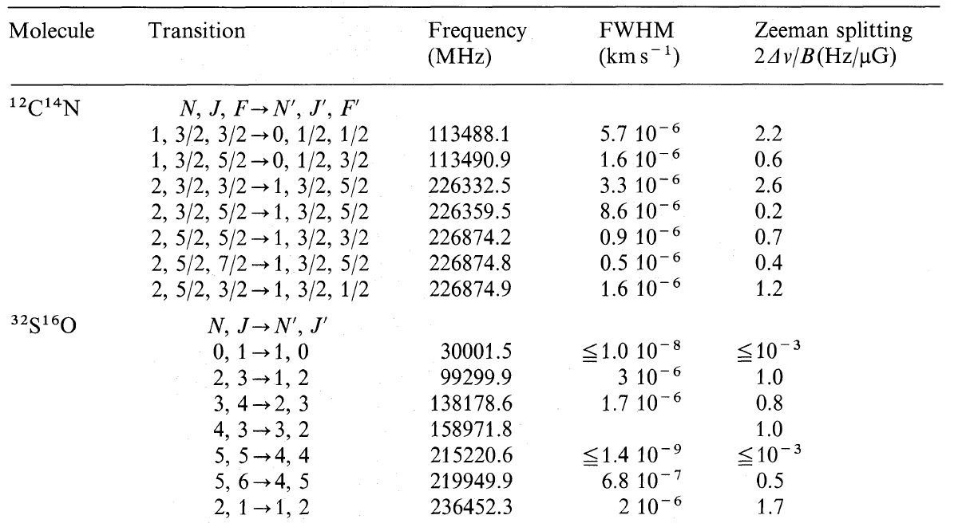
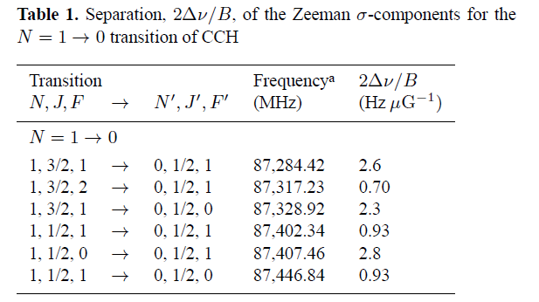
Zeeman effect
D. Crutcher’s presentation
Splitting of spectral line into different components under B-field
One has RCP, another has LCP
Frequency separation between RCP and LCP provides B-field strength
In case radiation field is anisotropic in the source, the emission can be linearly polarized. (known as G-K effect)

Slide 11
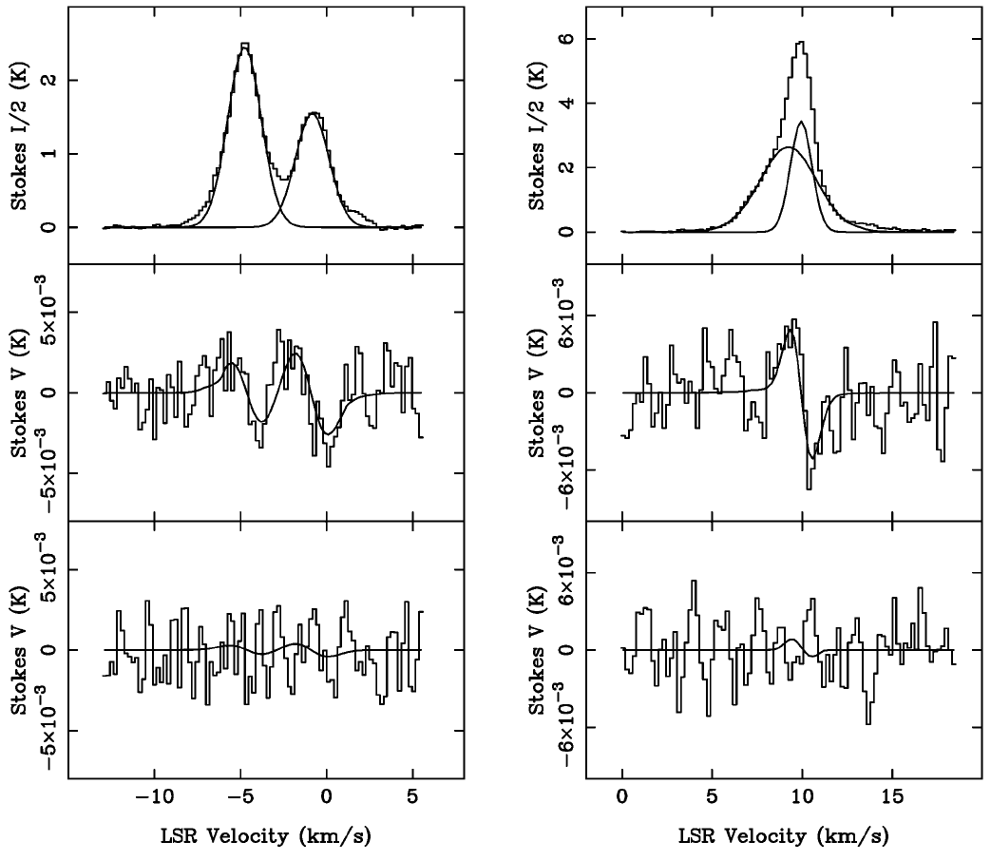
Zeeman effect
Observation of Orion using IRAM 30m
Detection of CN Zeeman
B_{los}=-0.36 +/- 0.08 mG on OMC1
V_{gas} ~ V_{alfven}
Gas motions are due to MHD wave
Crutcher+ 1999

Slide 12
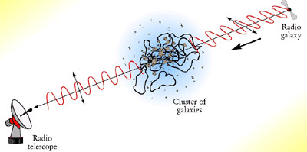
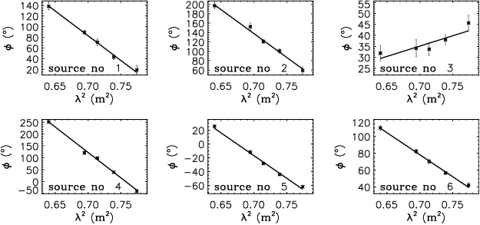

Faraday rotation
Propagation effect
EVPA rotation in magnetized plasma
Rotation angle ∝ λ²
RM (∝n_{e} B_{los}) can be a clue for LOS B-field.
$λ^{2}$law
Graphs of polarization angle against wavelength squared for polarized extragalactic sources in the field (Haverkorn, Katgert, & de Bruyn 2003).

Slide 13
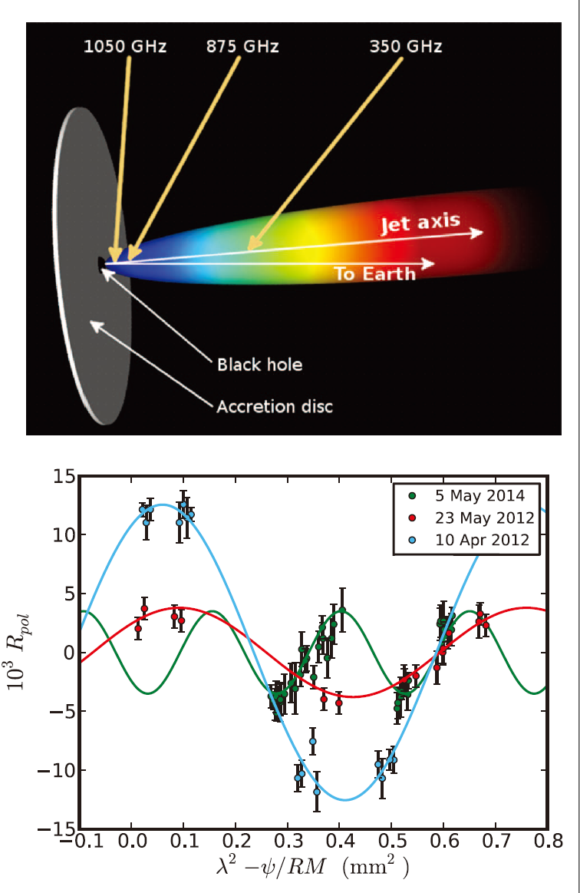
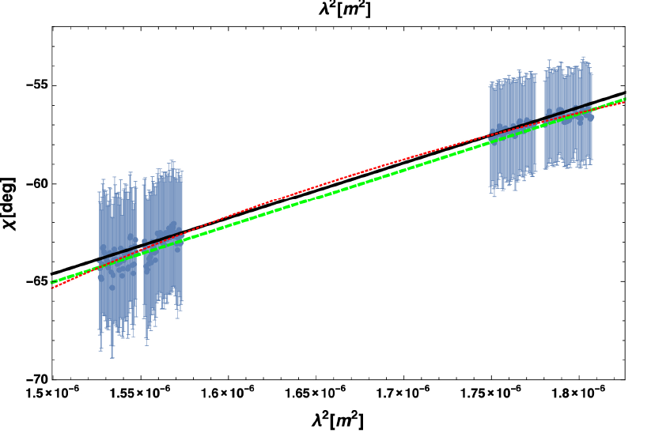
Faraday rotation
Marti-Vidal+ 2015
Hovatta+ 2019
5 x 10⁵ rad/m² on quasar 3C 273
Very high RM (~10⁸ rad/m²) on quasar PKS 1830-211

Slide 14
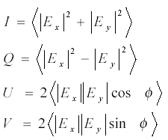
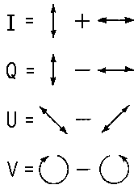
Stokes Parameter
Mathematical representation of polarization
In the unit of power
Q, U: linear polarization
V: circular polarization

Slide 15
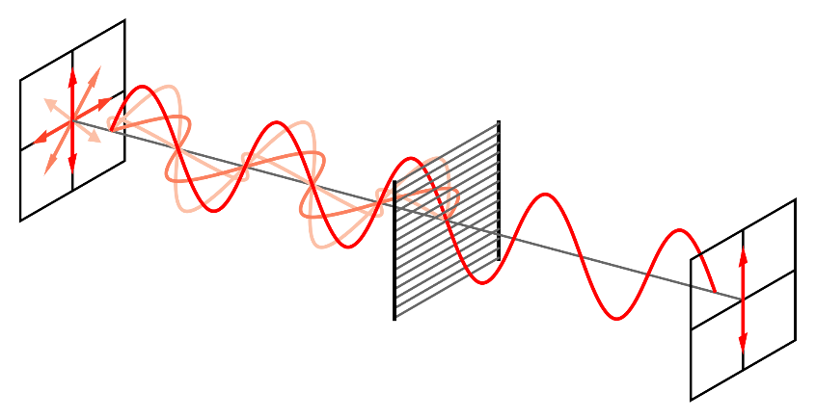
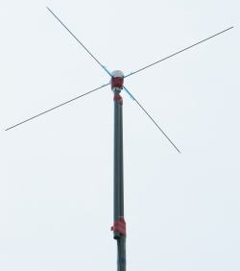
Polarimetry
Polarization filter used in optical. Requiring rotation of the filter to measure the polarization direction.
We can directly measure the amplitude and phase of two orthogonal linear polarization in radio, using such as cross-dipole antenna.
X
Y

Slide 16
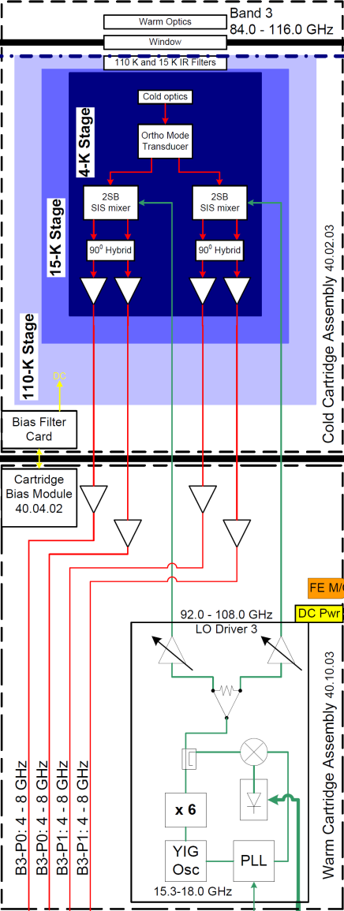
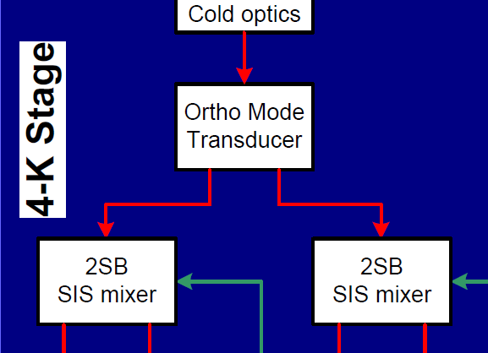
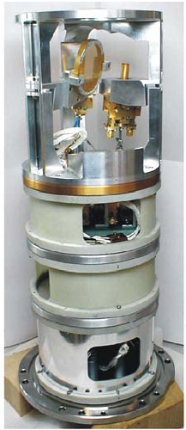
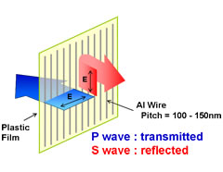
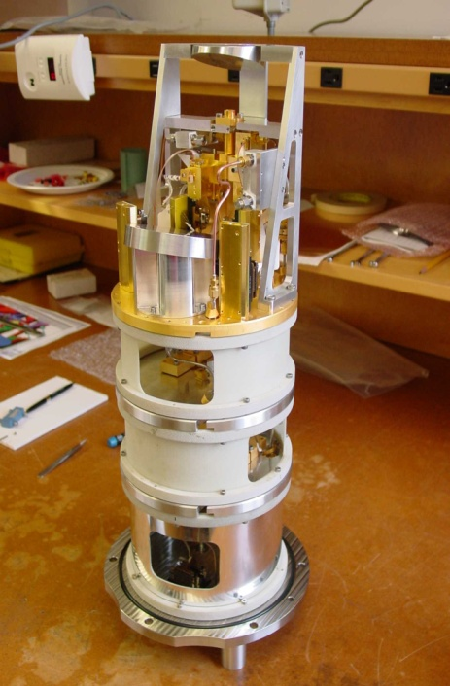
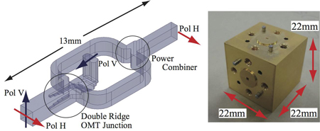
ALMA Frontend
Band 3/4/5/6/8: OMT
Band 7/9/10: Wire grid
Xpol
Ypol

Slide 17
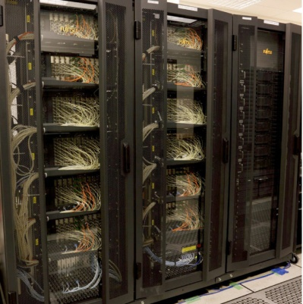
ALMA Correlator
Xpol, Ypol
Antenna m
Cross correlation (XX, YY, XY, YX)
Xpol, Ypol
ALMA correlator
Ψ: parallactic angle
Antenna n
4 cross correlations per baseline

Slide 18
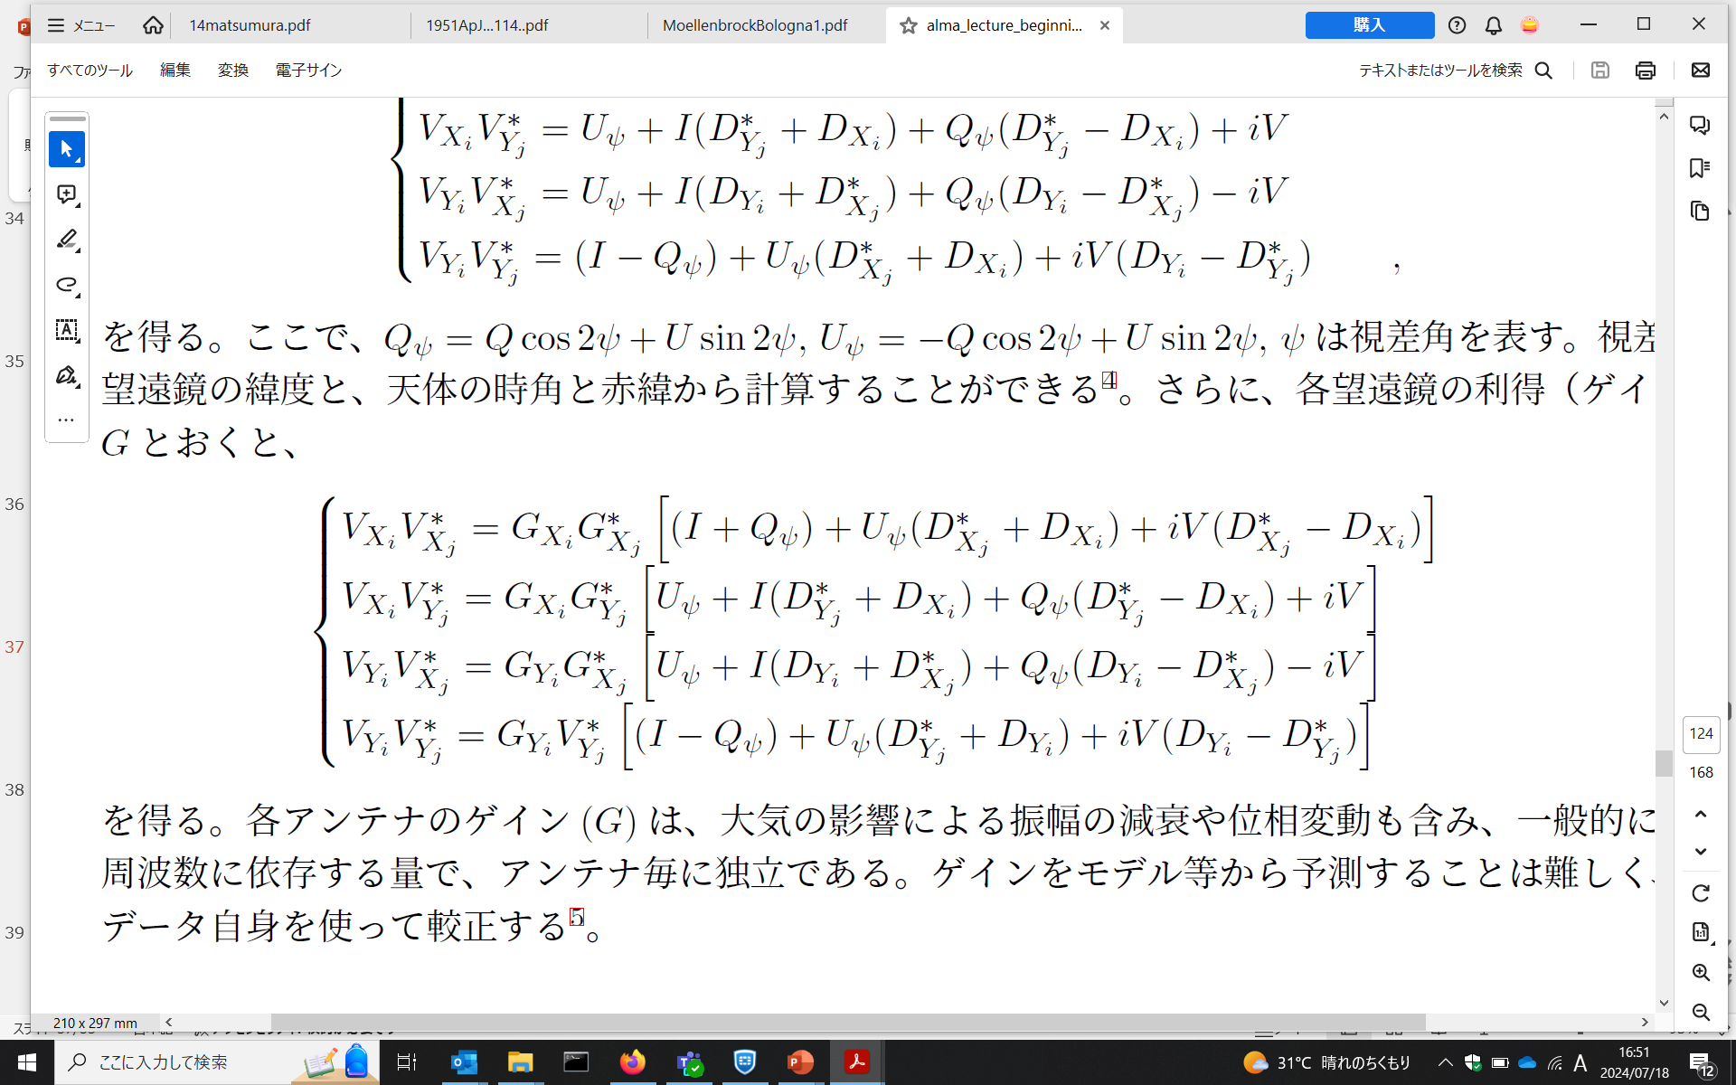
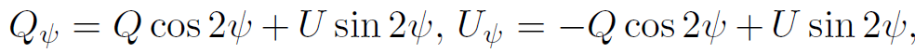
Instrumental polarization
The D terms: fraction of the input signal voltage in one polarization that leaks into the output of the other polarization. Typically few-several %.

Slide 19
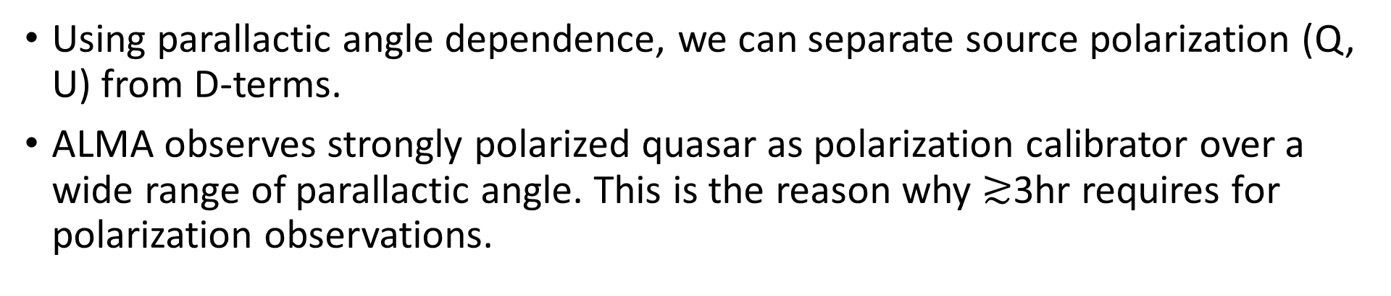
Calibration of instrumental polarization
For simplicity, let’s assume V=0.
Using parallactic angle dependence, we can separate source polarization (Q, U) from D-terms.
ALMA observes strongly polarized quasar as polarization calibrator over a wide range of parallactic angle. This is the reason why $≳$3hr requires for polarization observations.

Slide 20
XY phase calibration
Relative gain (Gx and Gy) can be calibrated by standard total intensity calibration, but the phase difference between X and Y for the reference antenna (ρ), so-called XY-phase, cannot be constrained.
Obtain ρ by fitting <XY*>+<YX*> on complex plane.

Slide 21
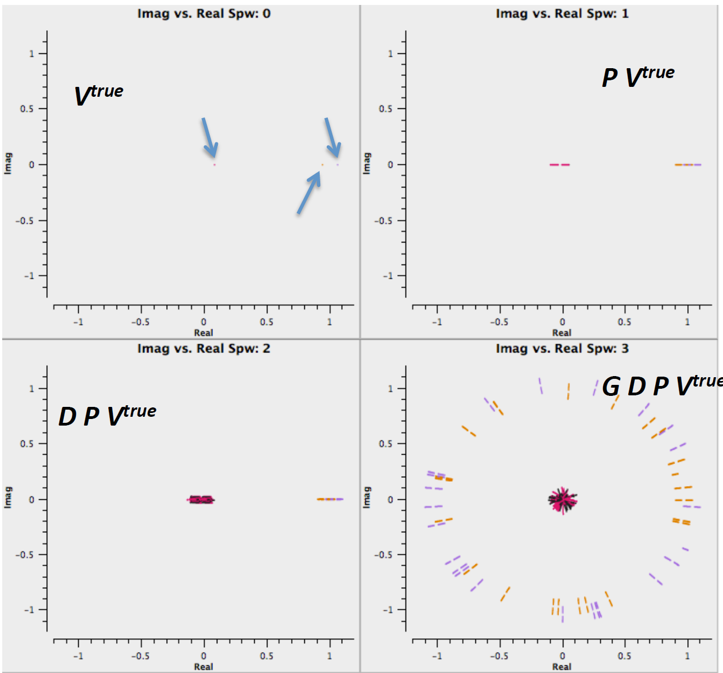
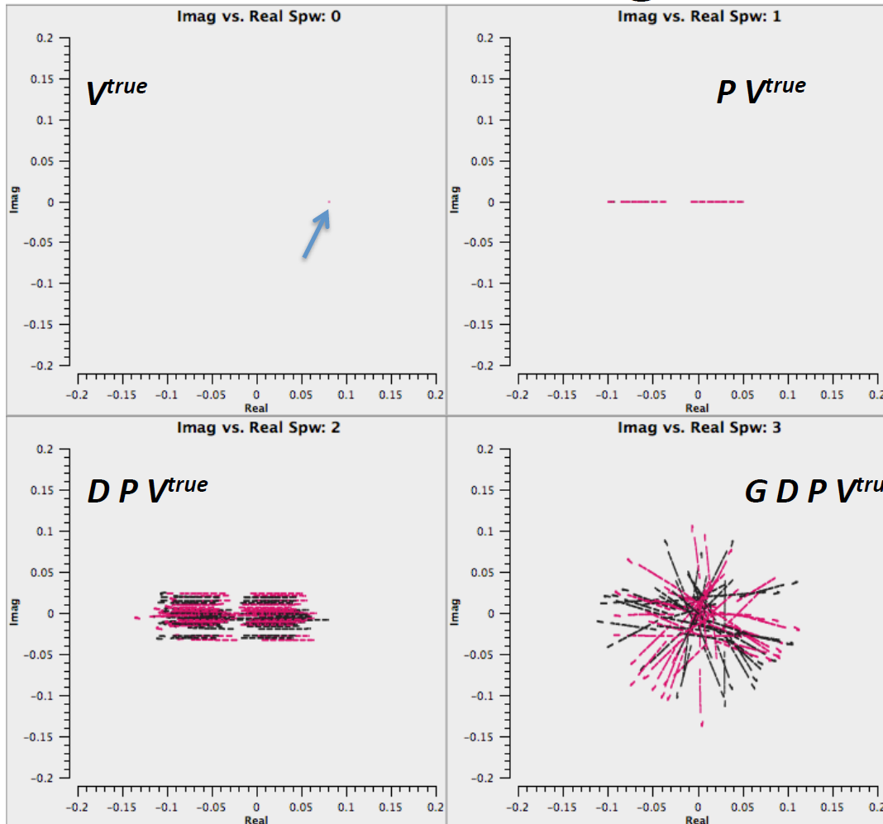
Visualizing Polarization Effects (Simulation)
I=1, Q=0.06, U=0.08, V=0 (no noise)
V_{XY}, V_{YX} only
Parallactic angle effect
Adding D-terms
Adding XY-phase and gain
Credit: G. Moellenbrock (NRAO)

Slide 22
Note for polarization imaging
Deconvolution (CLEAN) needs to be done on I, Q, U, and V images separately.
Q, U, and V can be negative, so do not forget to put CLEAN mask at negative emission components.
Spatial structures are not always similar among I, Q, U, and V. Different shape of CLEAN masks should be applied on different Stokes parameters.

Slide 23
ALMA polarization capability
Systematic error of linear polarization: ~0.1% at on-axis (<1/3 of PB)
Mainly because of calibration residuals of D-terms and XY-phase
Systematic error of EVPA: ~1 deg at on-axis (<1/3 of PB)
The errors increase to ~0.5% and 5 deg near the FWHM for linear polarization intensity and EVPA, respectively.
Systematic error of circular polarization: ~1.8% within 1/10 of PB
Combination of multiple reasons

Slide 24
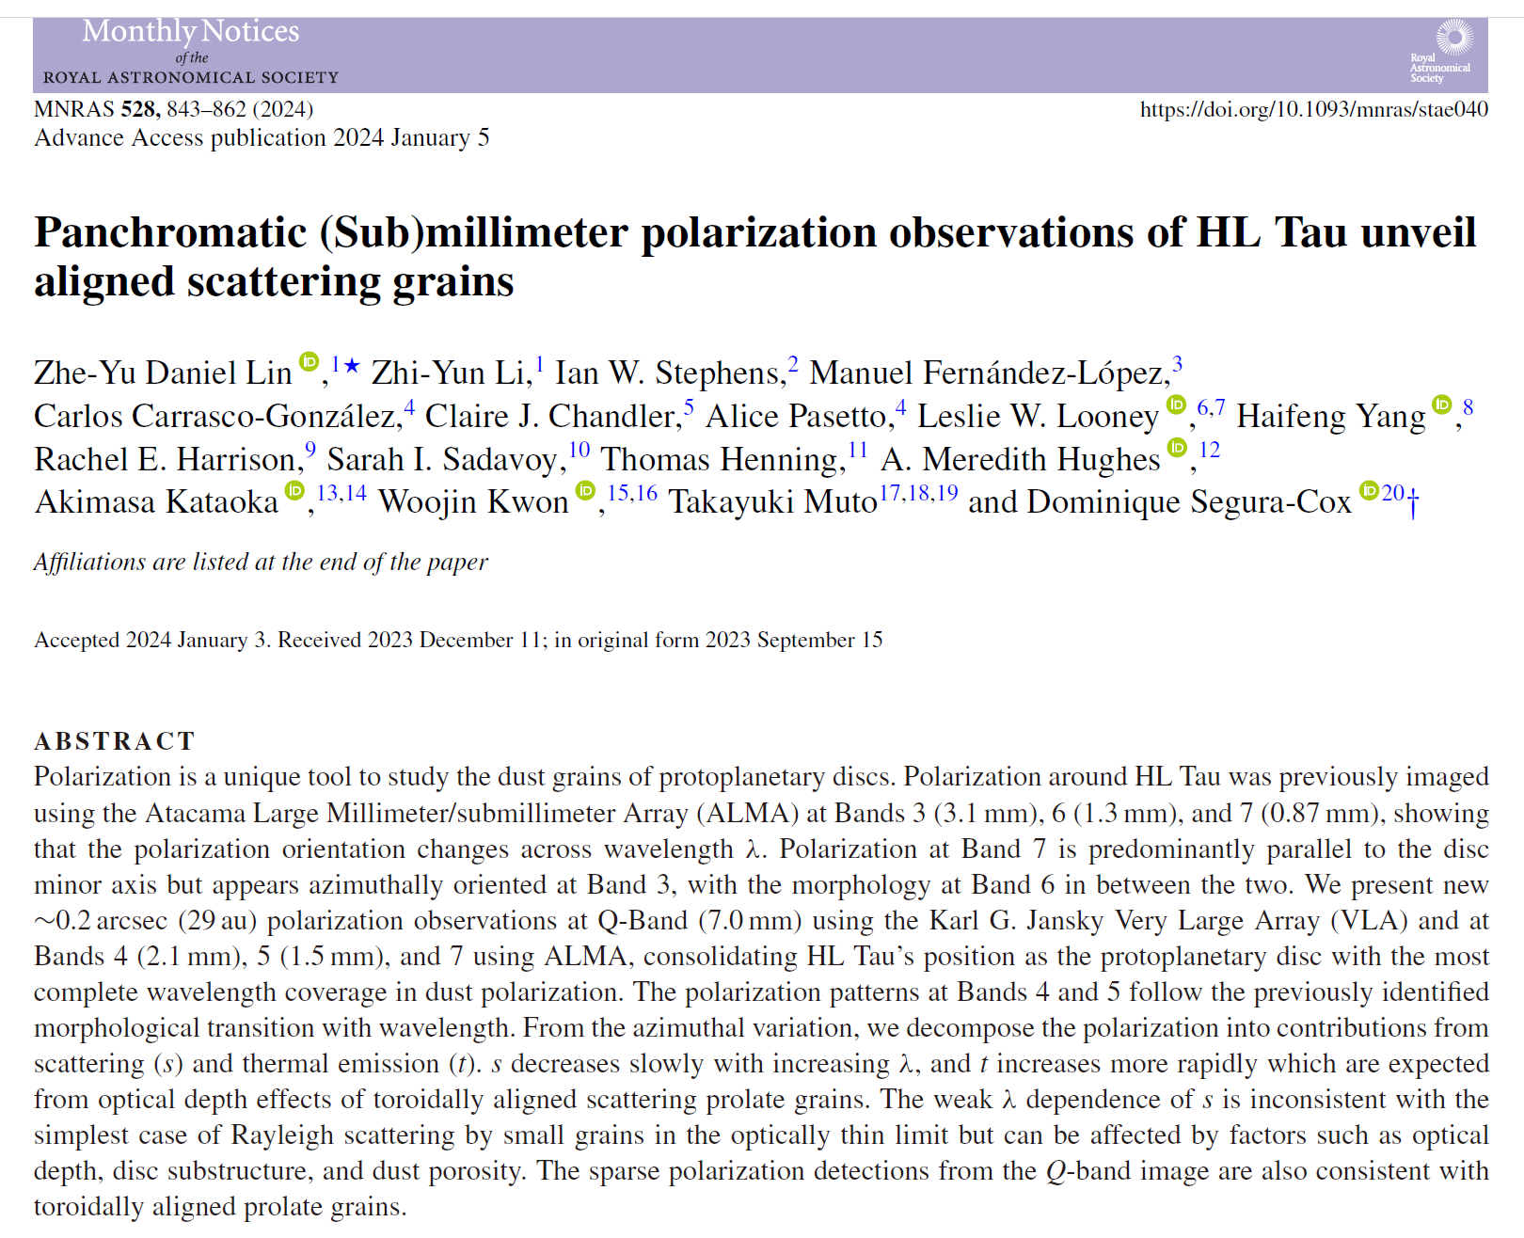
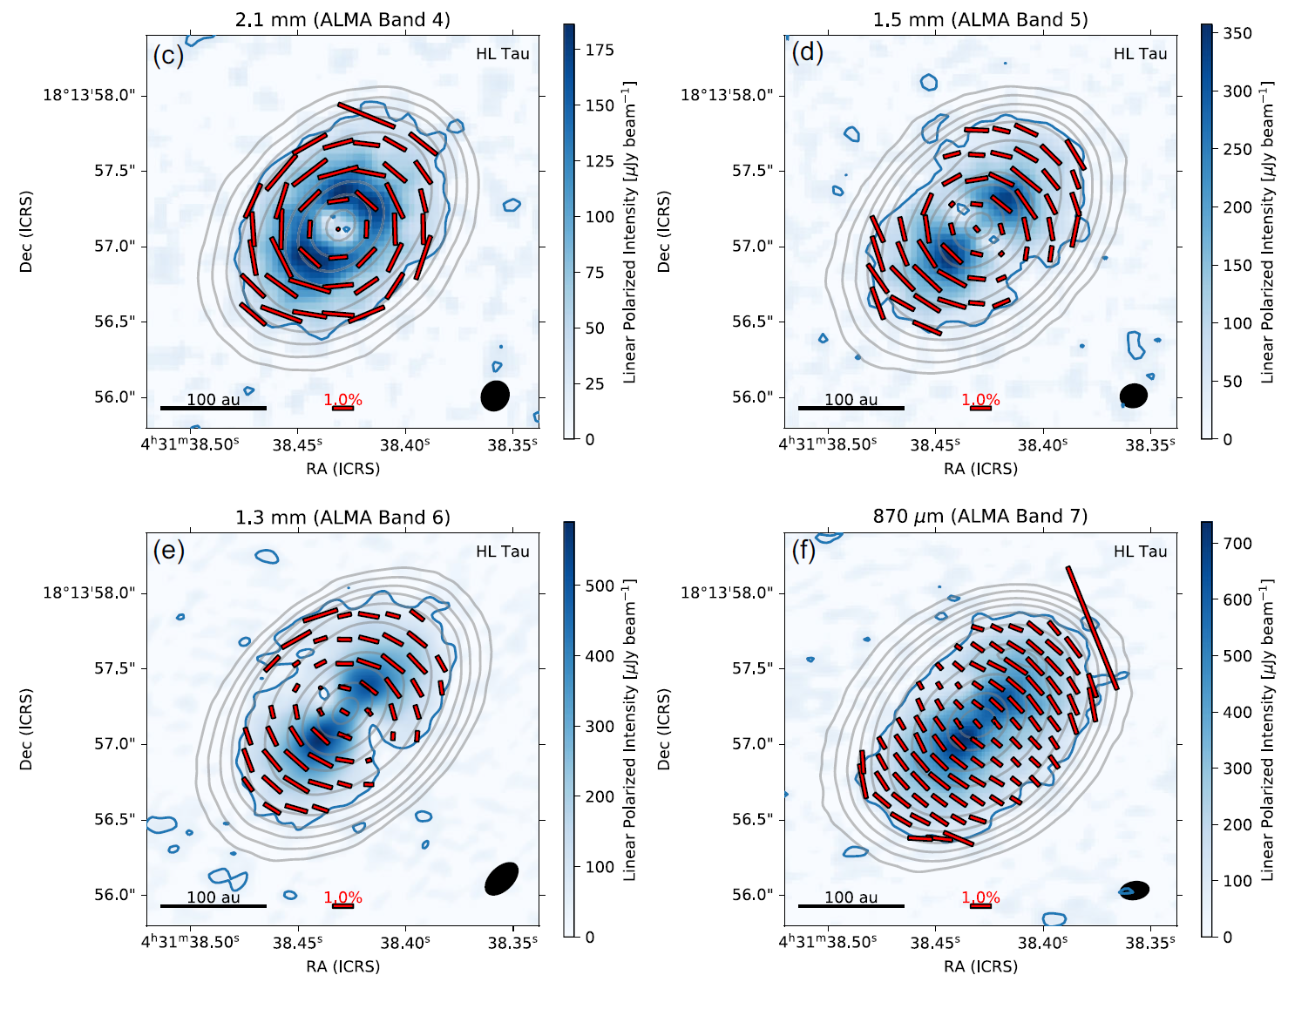
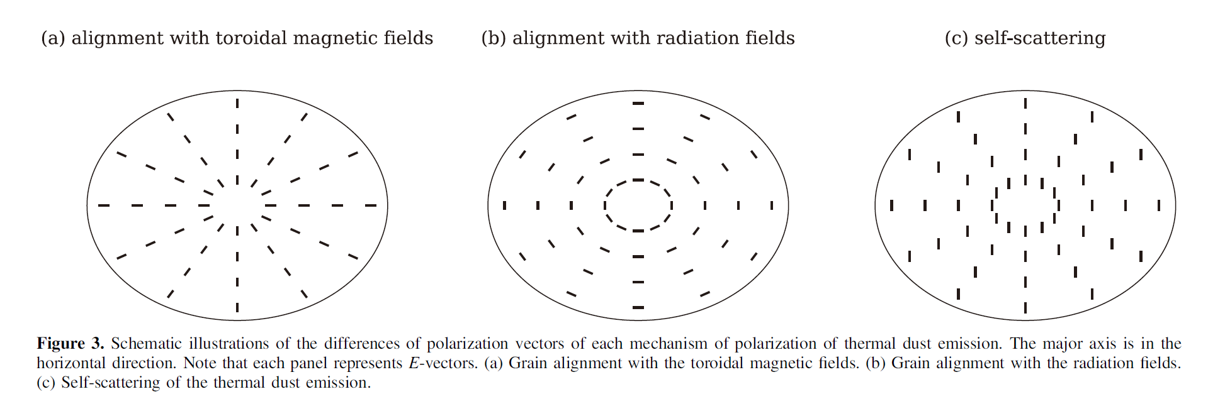
Data for hands-on tutorial
Lin et al. 2024
Band 4 continuum polarization
Calibrations have been applied.
This data
Kataoka+ 2017

Slide 25
More information on hands-on session
https://share.evernote.com/note/a09dea70-c658-836f-8a99-1e1ddeccc6a6

