Slide 1
Multi-Band Group
Erhching Yang, Kibeop Lee, Kushagra Srivastav, Li-Hwai Lin, Yu Hung, Shu Ishibashi
Special Thanks to Tutors : Kotomi Taniguchi, Jinshi Sai

Slide 2
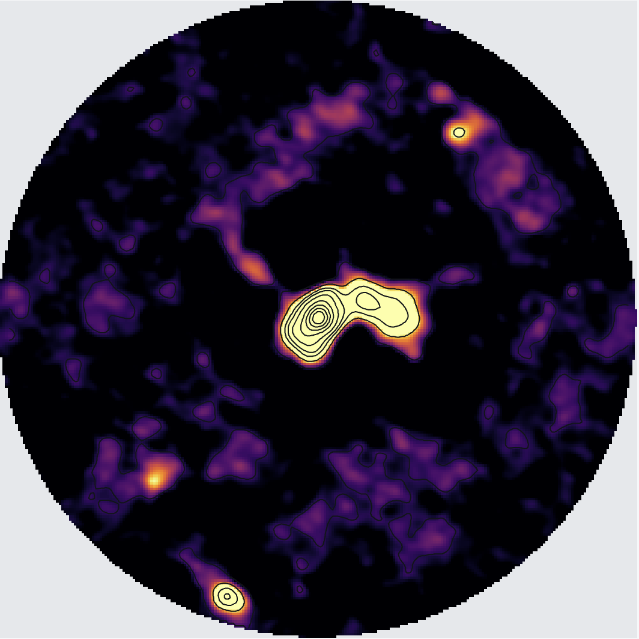
Introduction - G343.12-0.06 (IRAS 16547-4247)
a high mass, luminous young stellar object
(O-type proto binary system)
band3 continuum image
We start from producing the continuum image by tclean, create the data products, and then analyze the scientific properties.
In the mm and (sub)mm bands, the spectral index is expected to be around 3–4 because of the dust thermal emission.
We also have data cube, where we identified multiple CH3CN transitions and used them to calculate the column density.
contour: 0.1, 1, 2, 3, 5, 7, 9, 13, 17, 21 sigma

Slide 3
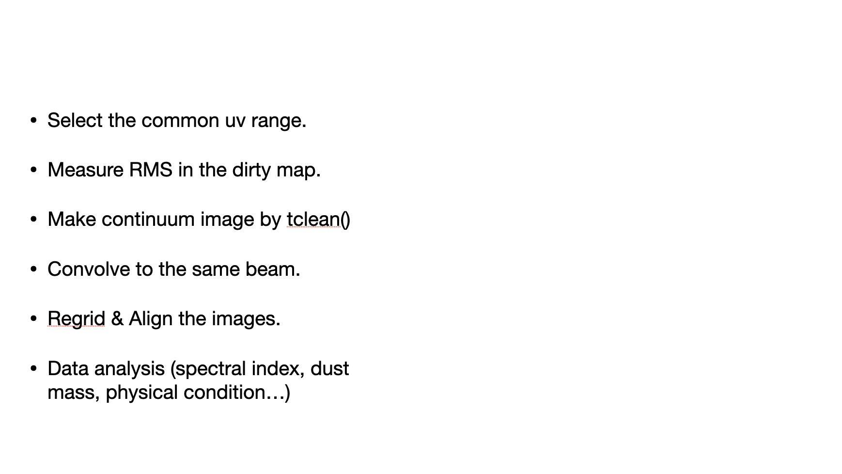
Data Reduction

Slide 4
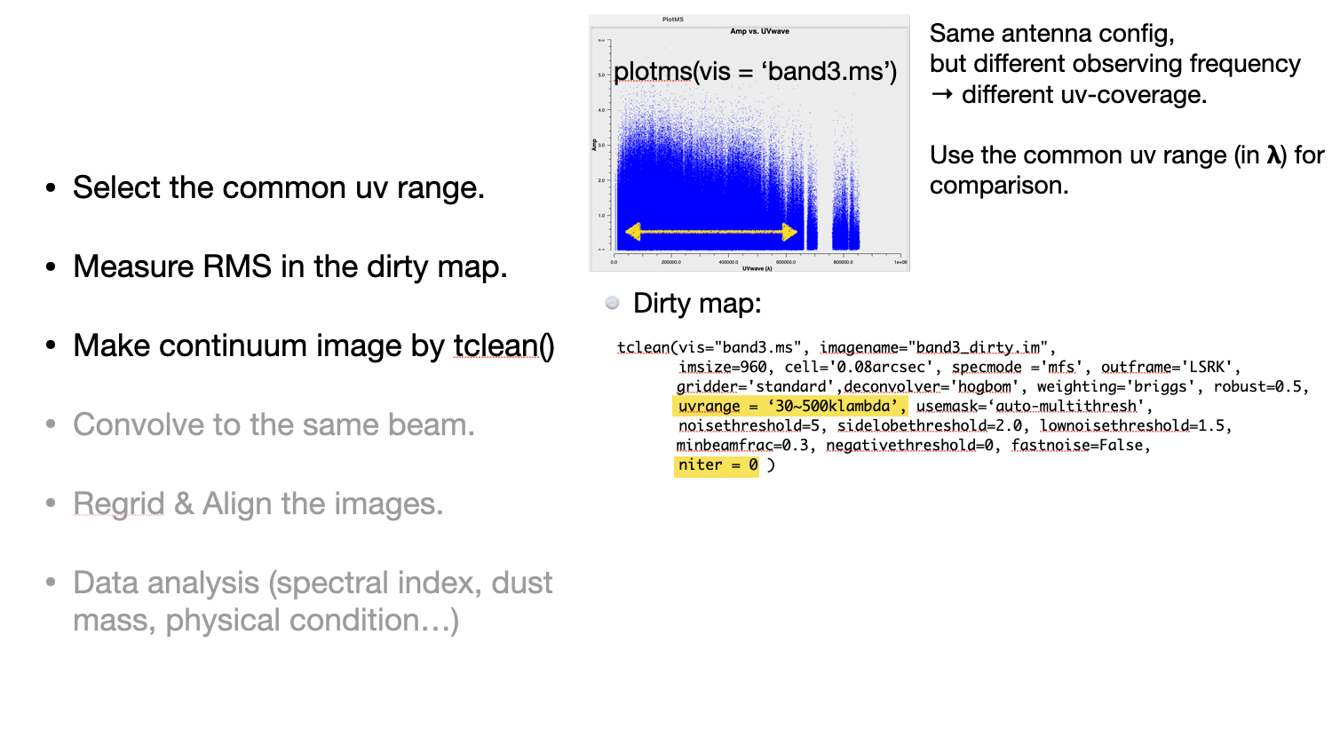
Data Reduction

Slide 5
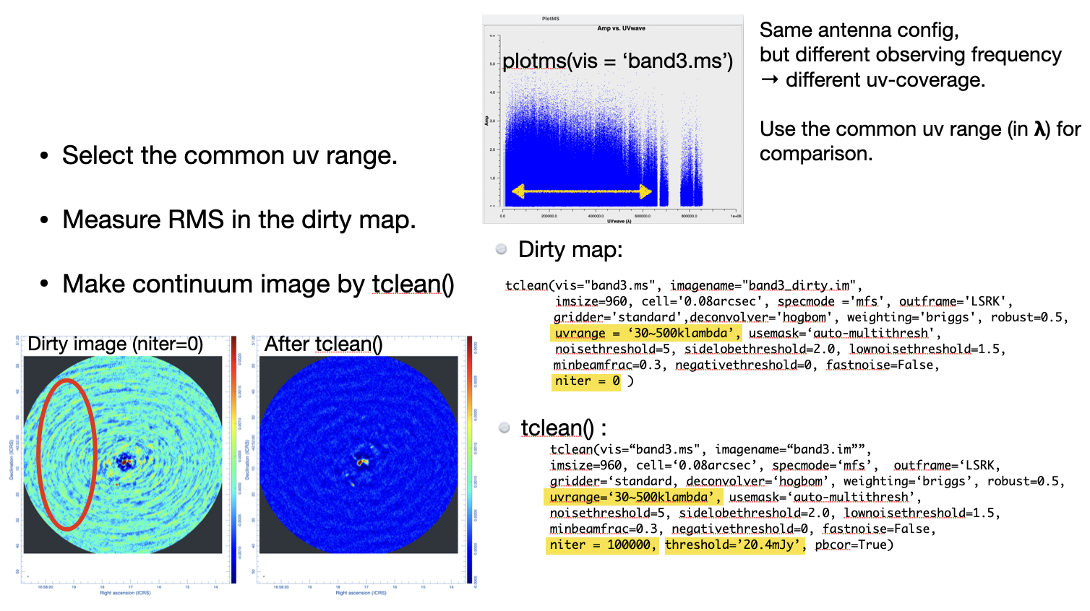
Data Reduction

Slide 6
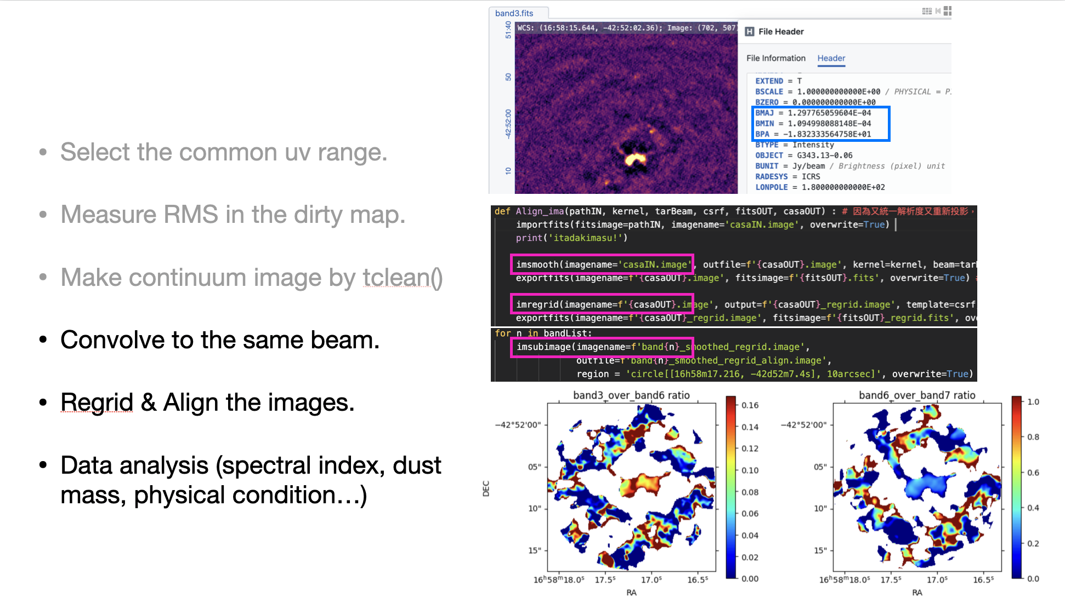
Data Reduction

Slide 7
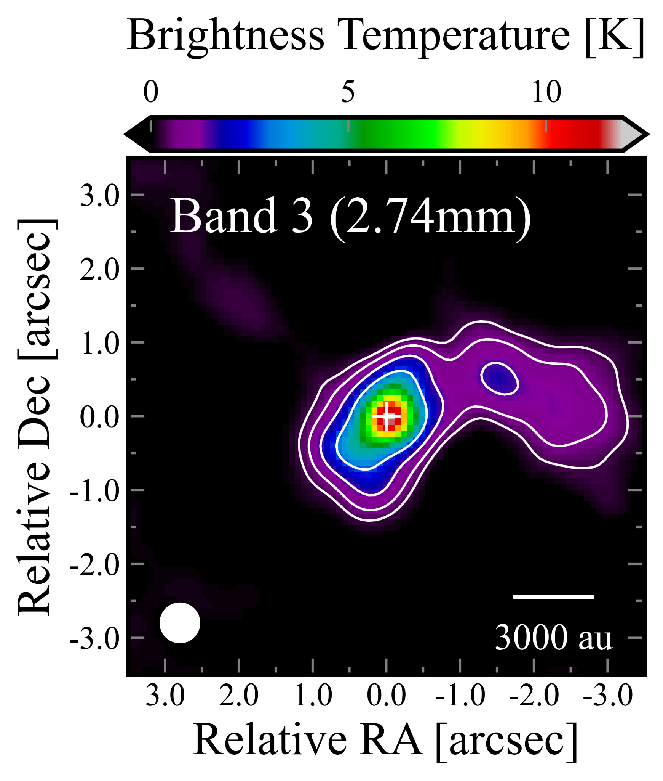
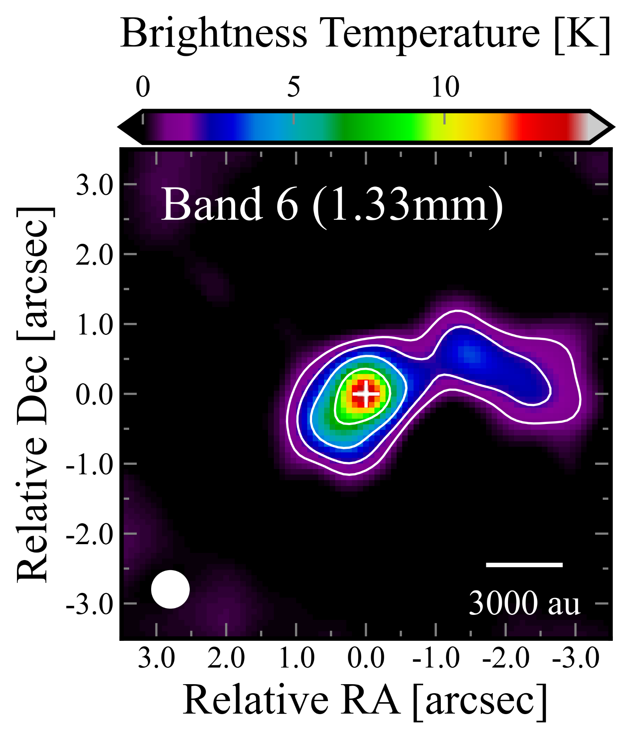
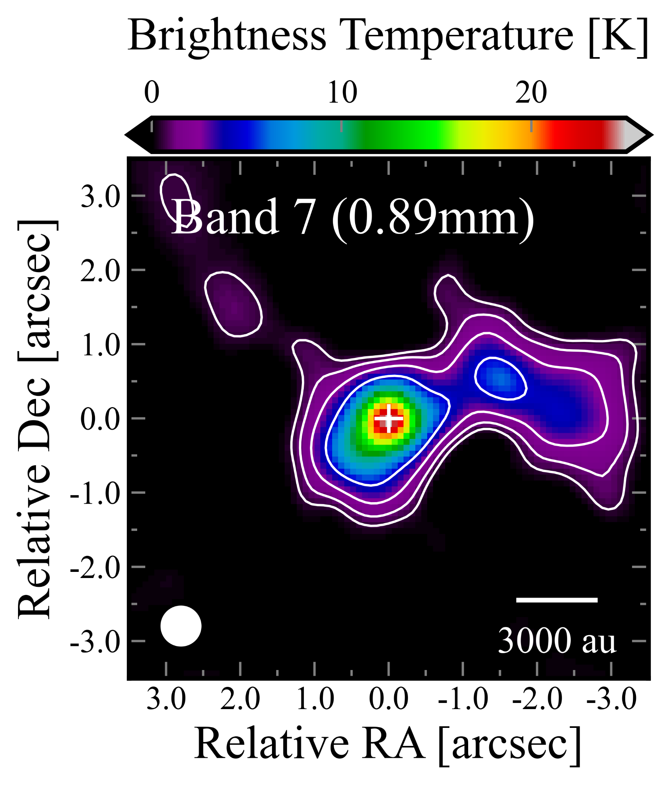
Results — Continuum images
0”.54×0”.54
0”.54×0”.54
0”.54×0”.54
・robust = 0.5
・After the smoothing, the angular resolution is 0”.54 ~1500 au

Slide 8
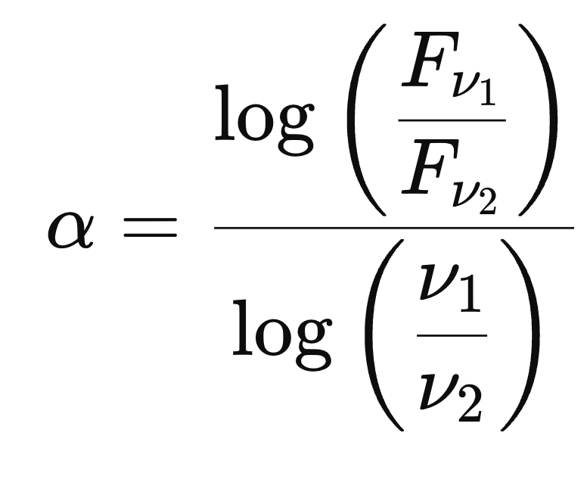
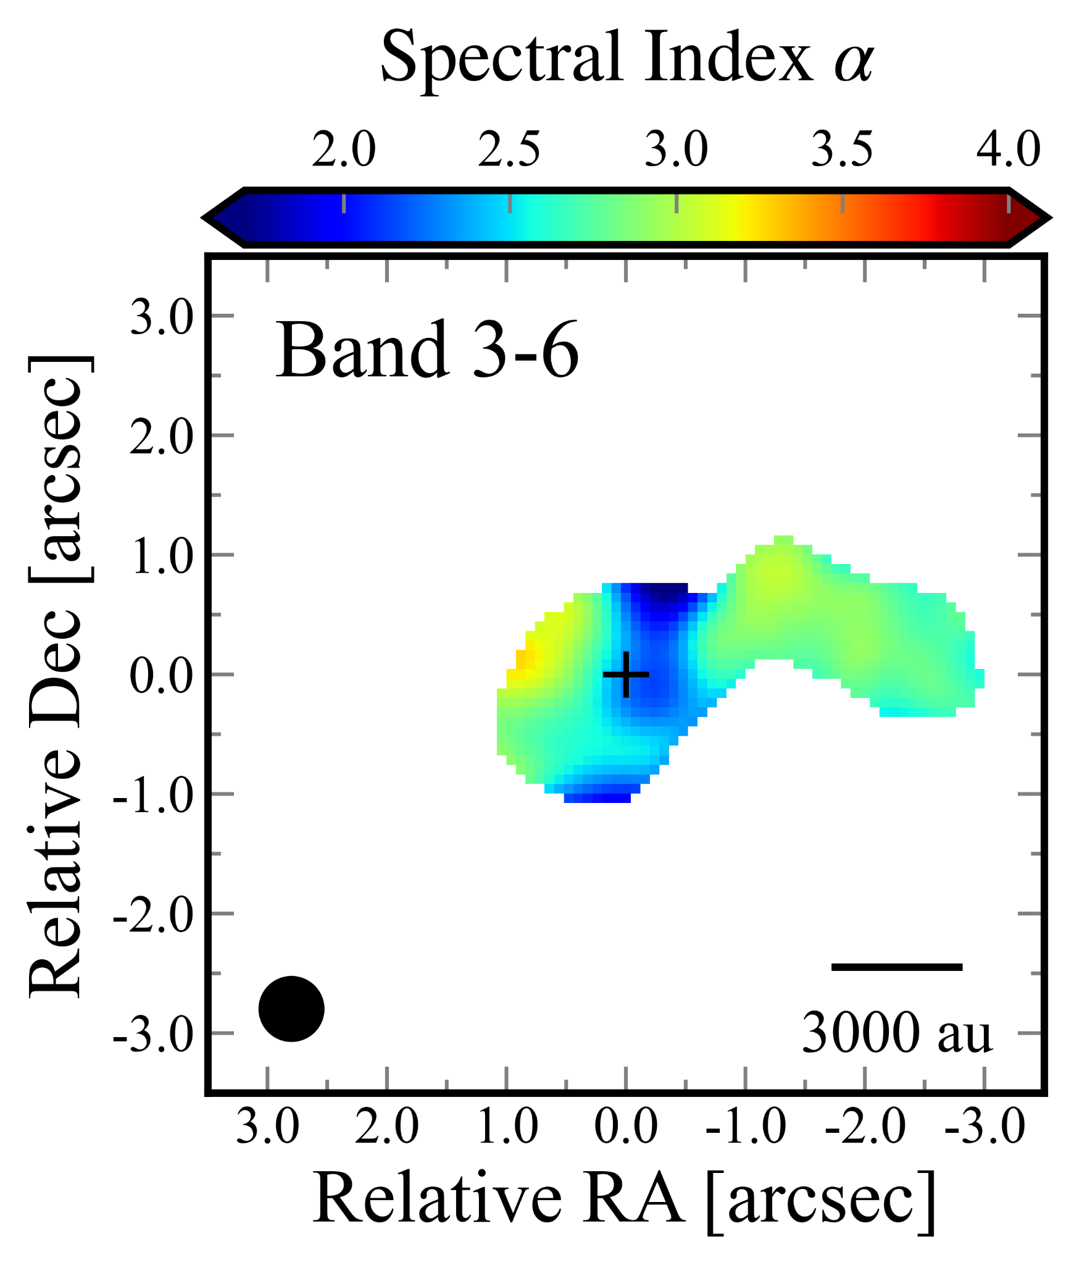
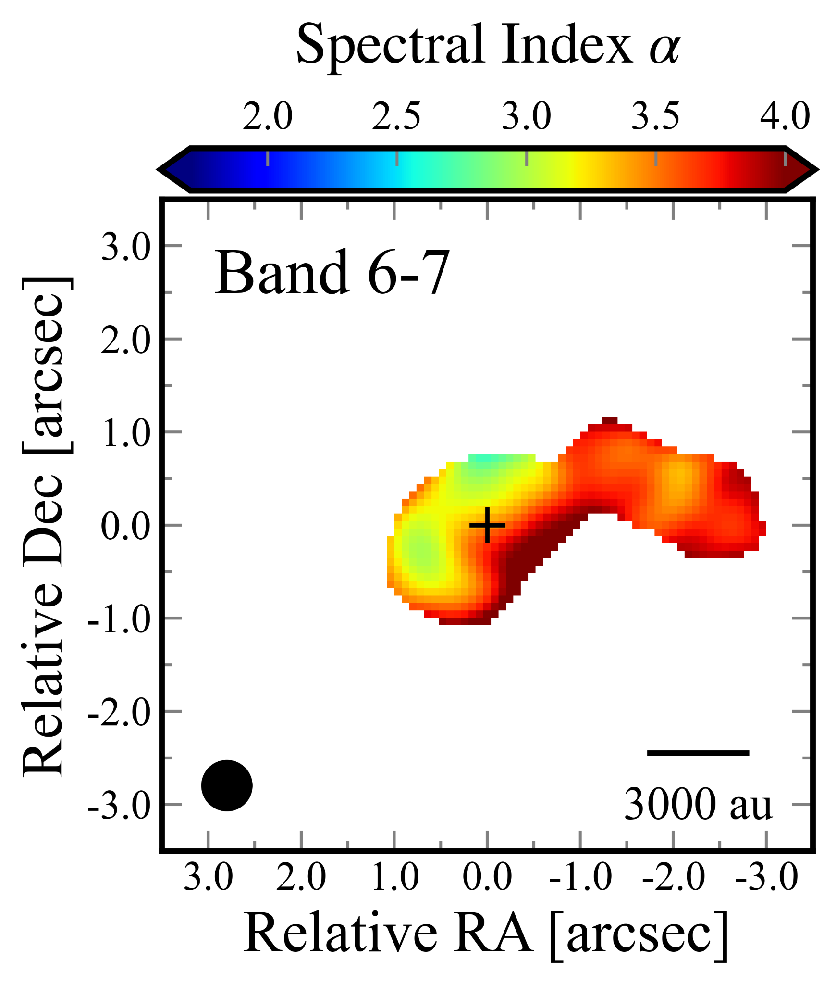
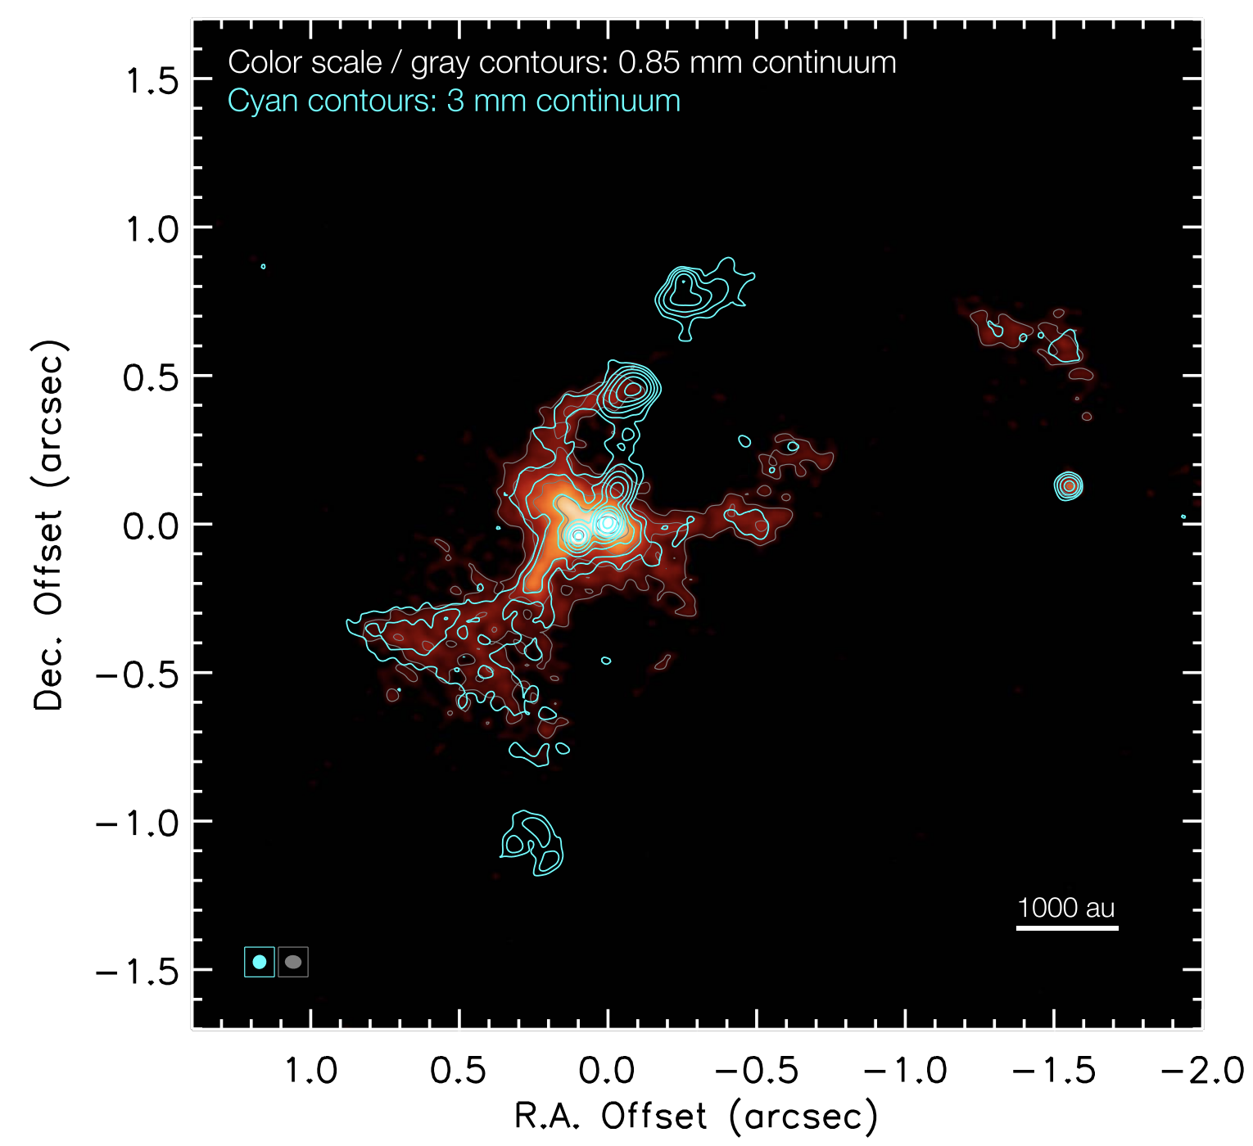
Results — Spectral index α maps
・Spectral index α is defined as

Slide 9
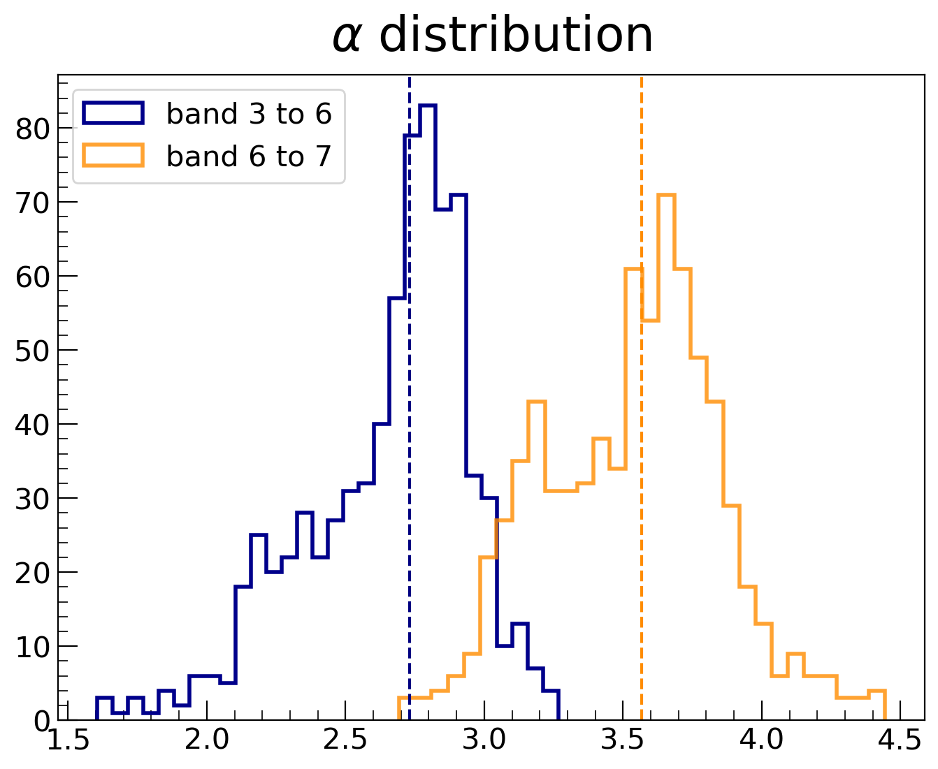
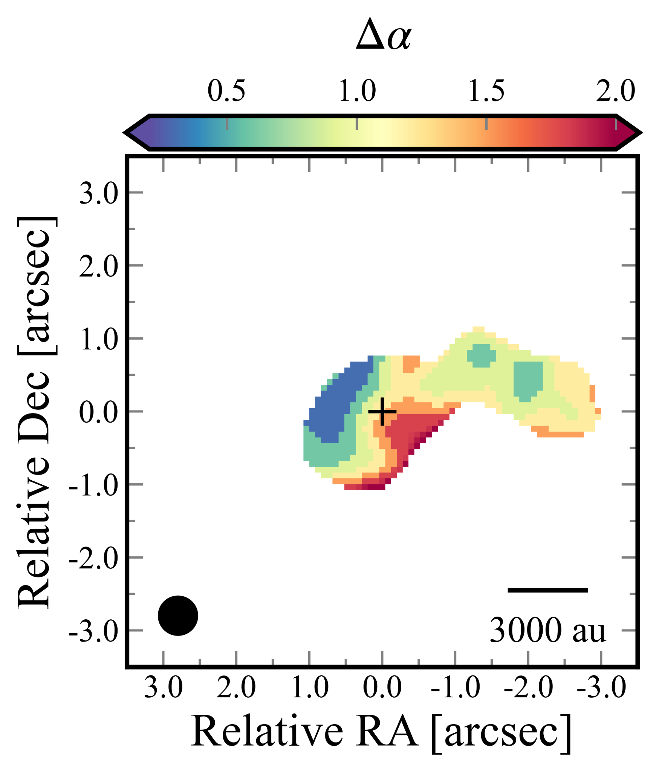

Results — Overall trend of α map
the trend of the spectral index is different!

Slide 10
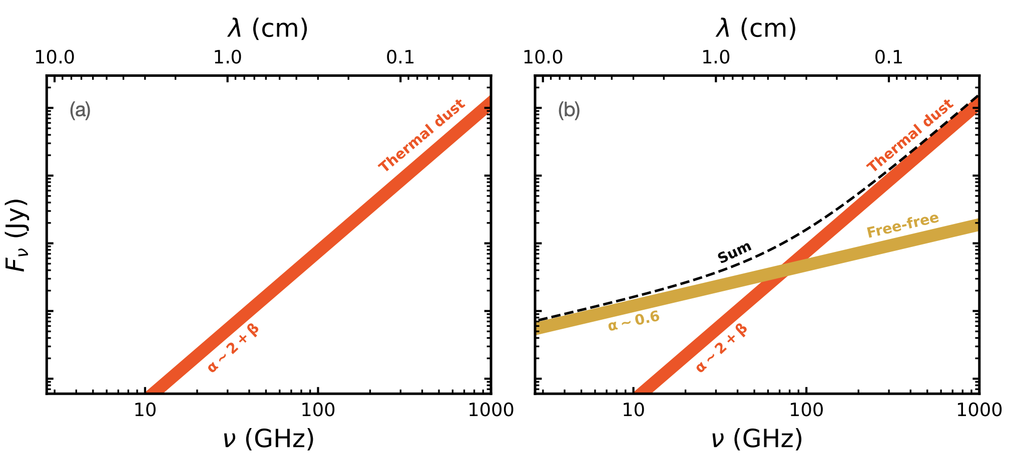
What do α(Band3-6) & α(Band6-7) mean?
Band 3, 6, 7
Curone et al. 2023
free free emission could decrease the spectral index

Slide 11
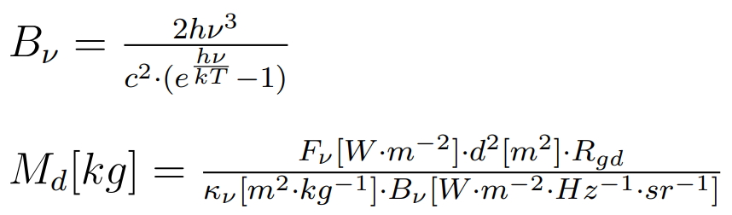
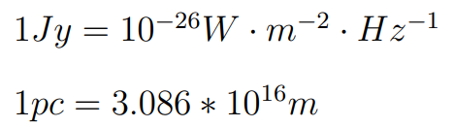
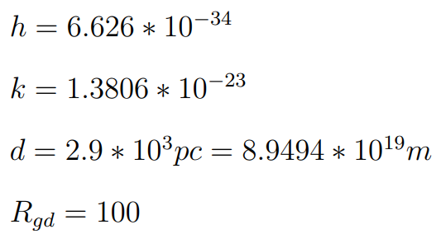
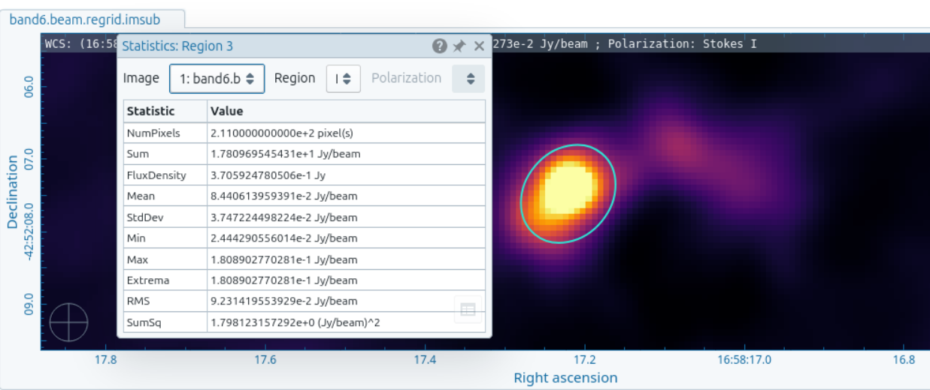
Dust mass - How to calculate it?
The formulas we used:
unit convert
The parameter we already knew:
Flux:
(gas-to-dust mass ratio)
Notes:
In observational data, continuum emission is often used to estimate the dust mass, which can then be used to interpret the star formation. Therefore, here we calculate the dust mass for further analysis.
First, let me explain how we calculate it.
We use the two formulas compute the brightness temperature and dust mass, and we first convert all units to the SI system to make subsequent calculations easier.
Many of the parameters in the formulas are already known, such as the Planck constant, Boltzmann constant, the distance to the source, and the gas-to-dust mass ratio. This ratio refers to the gas mass divided by the dust mass, typically set to 100. Since our κ is defined for the total mass, we multiply by gas-to-dust mass ratio to convert the total mass into gas mass.
To calculate the gas mass, we need the flux of the source, which I obtained using the statistics tool in CARTA. For simplicity and because of time constraints, I focus on the brightest component, using a mask roughly corresponding to its estimated FWHM.
Finally, we perform the same procedure on the continuum images of all three bands, obtaining the flux for each band and then calculating the corresponding dust mass.

Slide 12
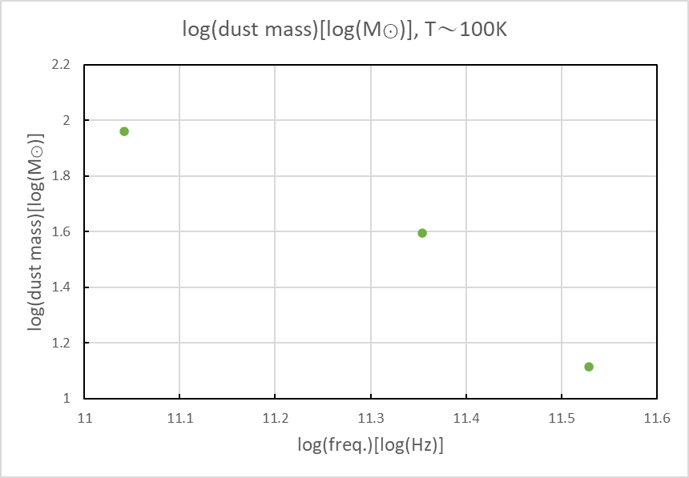
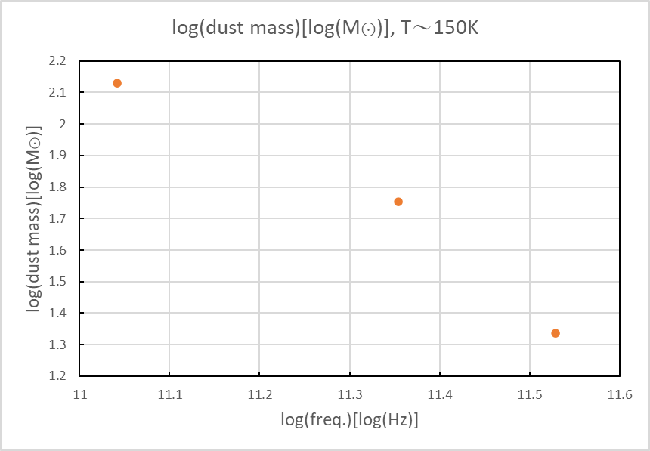
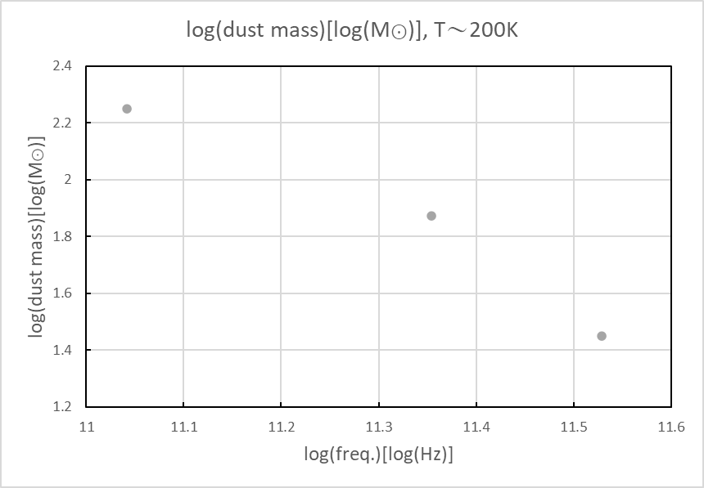
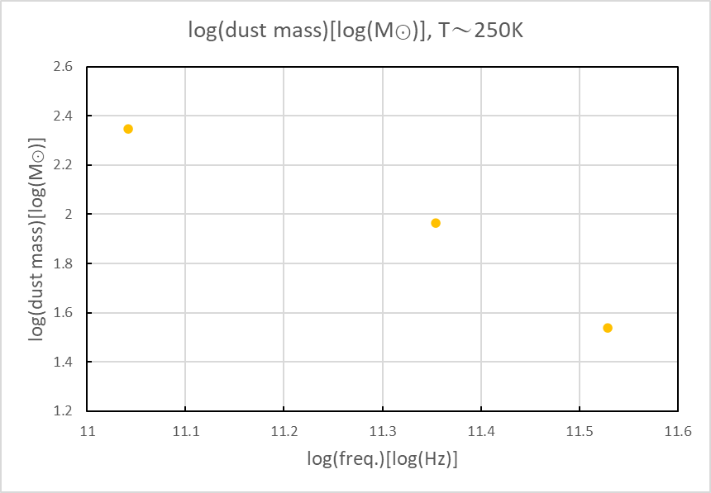
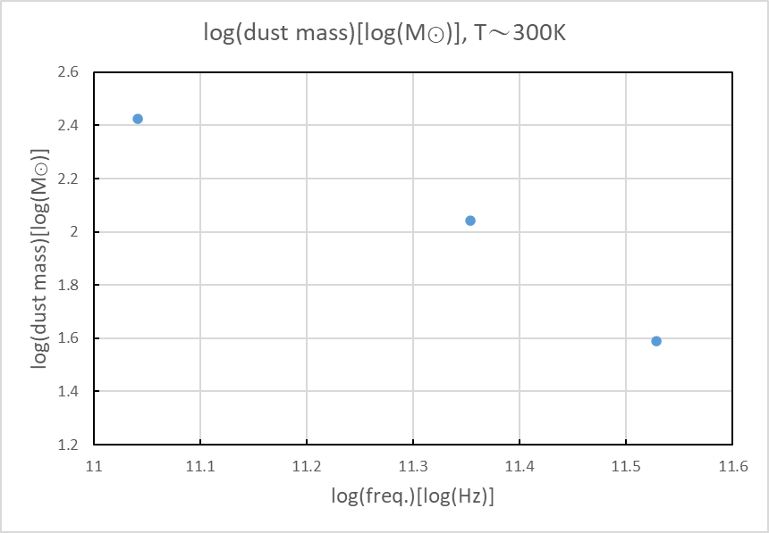
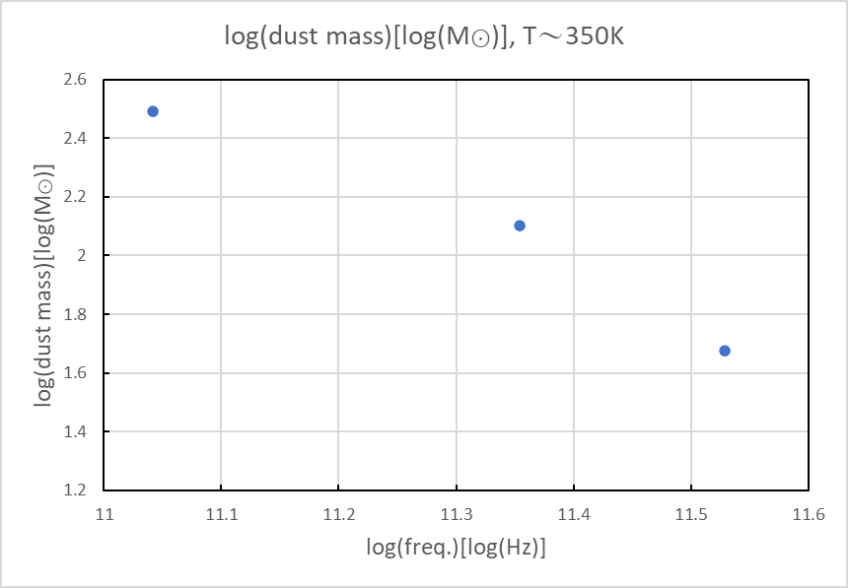
band | Dust Temperature(K) | Gas mass(M⊙)
3 | 100 | 91.5
 | 150 | 135
 | 200 | 178
 | 250 | 222
 | 300 | 265
 | 350 | 309
6 | 100 | 39.3
 | 150 | 56.8
 | 200 | 74.4
 | 250 | 92.0
 | 300 | 110
 | 350 | 127
7 | 100 | 13.0
 | 150 | 21.7
 | 200 | 28.1
 | 250 | 34.6
 | 300 | 38.9
 | 350 | 47.5
Dust mass - Preliminary results
Notes:
This is our preliminary result for dust mass.
Since we do not know the exact dust temperature of the source, we first assume a range to constrain it.
By comparing the dust mass derived from different bands, we find that the values in Band 3 are systematically higher, which may be due to contamination from free–free emission, leading to an overestimation of the dust mass in Band 3.
Next, we compare different assumed temperatures. Because the continuum image I use is unresolved, we cannot see a clear gradient, and the result is averaged into a single value.
Therefore, I tried assuming a temperature range of 100–350 K, with 50 K intervals, to calculate the corresponding gas mass for each case. Based on my results, a range of about 200–300 K seems to be the most reasonable.

Slide 13
Dust mass - Discussion
negative correlation, but
→ only three data points
→ Value in and band 3 is overestimated
＝＞Hard to interpret !!
Dust mass estimates differ across bands
Notes:
The preliminary results suggest a negative correlation between dust mass and frequency, with higher-frequency bands giving lower dust mass. However, since we only have three data points, this trend should be interpreted with caution. The overestimation in Band 3 is likely due to contamination from free–free emission, as mentioned before. Therefore, it is difficult to conclude whether there is any real correlation between frequency and dust mass. Instead, we can simply say that dust mass estimates differ across bands. Apart from flux being overestimated by non-thermal emission, the discrepancies may also be related to optical depth effects or the different sensitivities of each band, since different bands trace dust from slightly different regions and conditions.

Slide 14
Dust mass - Future work…
Compare the dust mass of different components
Compare the dust temperature of different components
High temperature
→ starburst activity or strong stellar radiation fields
Low temperature
→ low-mass star formation
Notes:
due to the time constrain, so I can’t do so much things. This is some works we could in the future.
First one is to compare the dust mass of different components to quantify their differences and assess the overall star formation potential.
Second one is to compare the dust temperature of different components to examine whether certain environments are more likely to form massive stars or primarily low-mass stars. Dust temperature provides a first-order indication of the environment: higher temperatures are usually associated with starburst activity or strong stellar radiation fields, which may favor massive star formation, while colder environments may be more conducive to low-mass star formation.

Slide 15
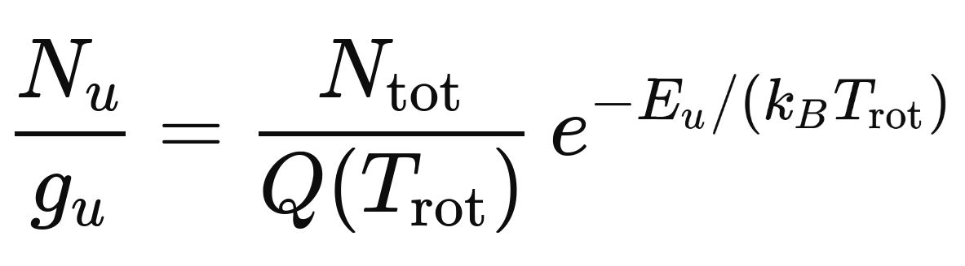
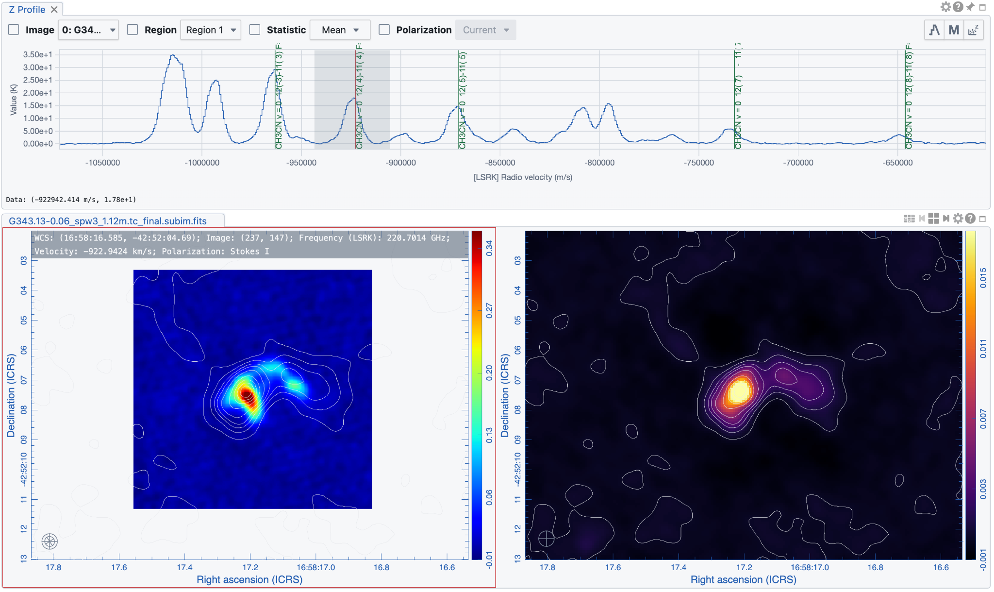
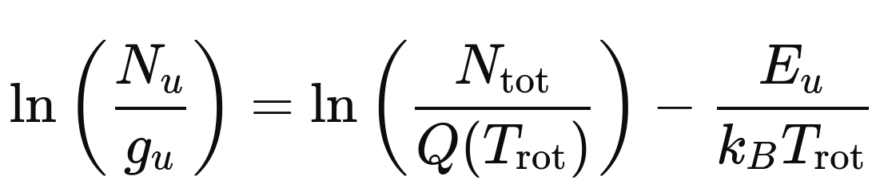
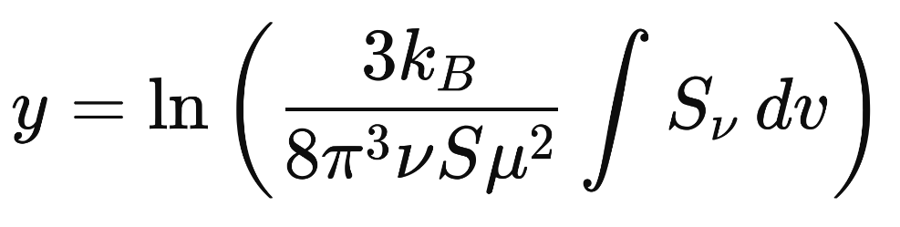
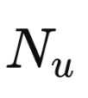
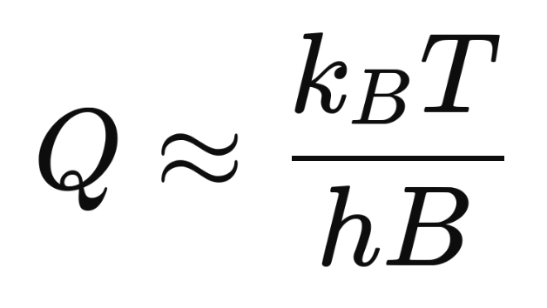
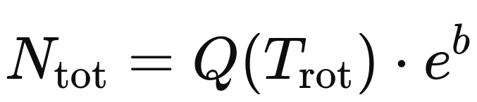
Column density of CH3CN and H2

Slide 16
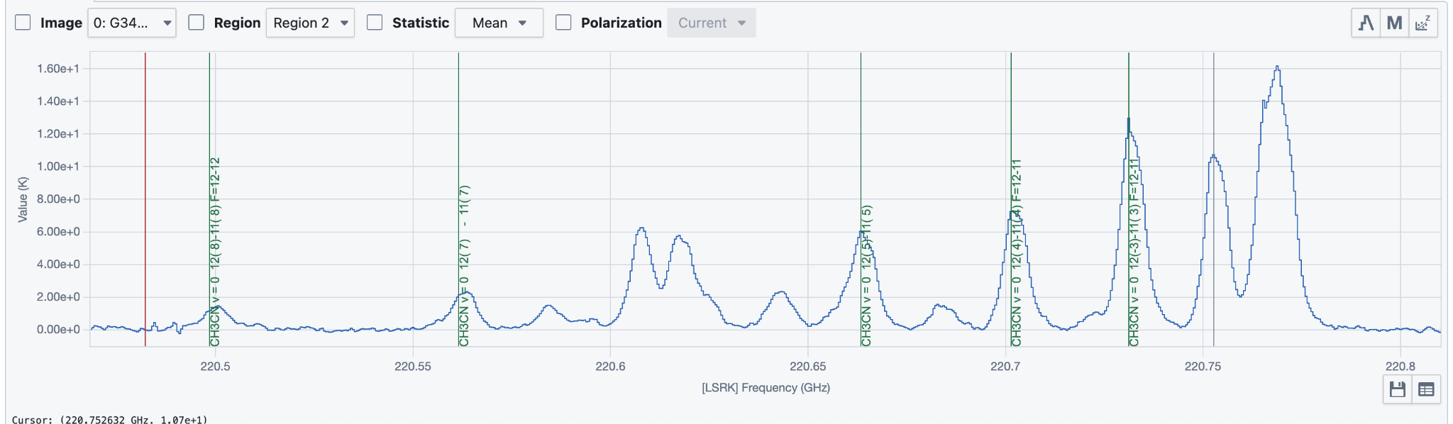
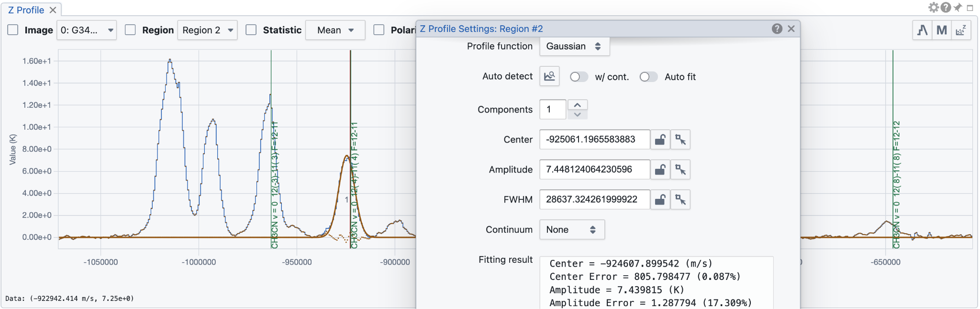

Slide 17
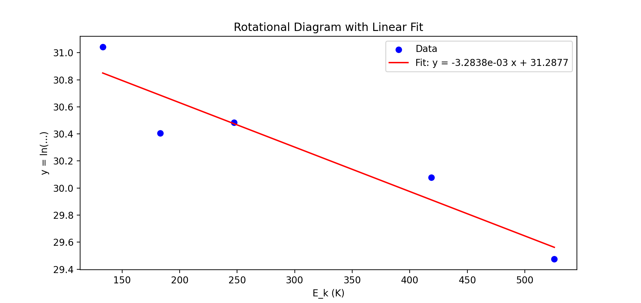
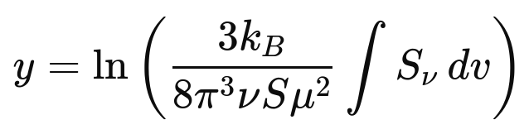
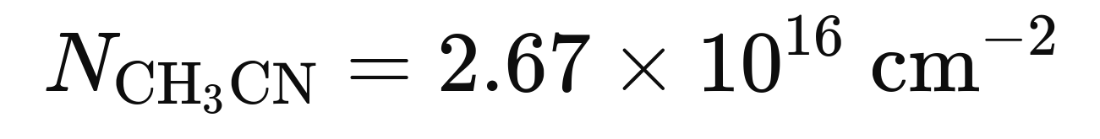

Slide 18
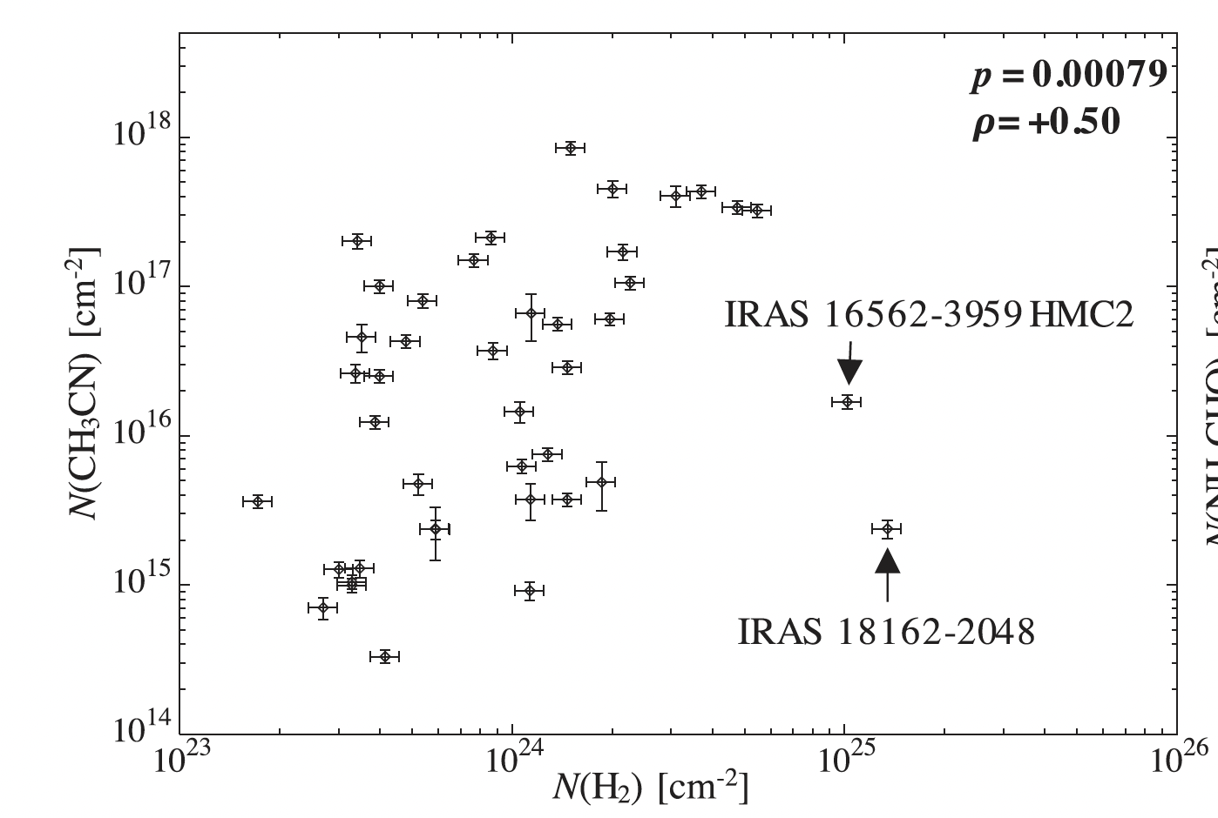
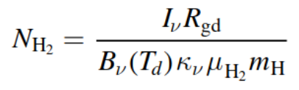
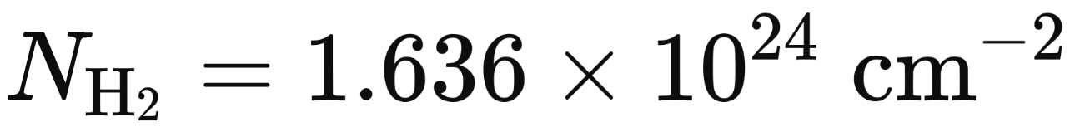
Taniguchi et al. (2023)

Slide 19
Summary
We have created continuum images for multi-band analysis (band 3, 6, 7)
uv range, beam matching, 2D convolving
From the analysis of the spectral index map, free-free emission could prevail for our target
By assuming the dust temperature, we have achieved the total dust mass within the SF region.

Slide 20
Thank You

Slide 21
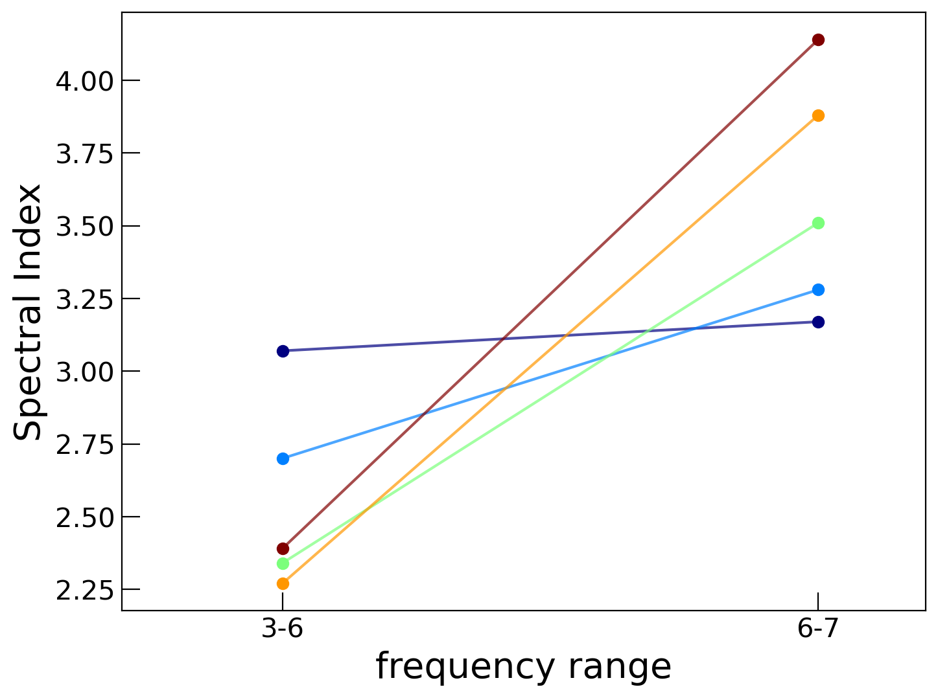
Appendix

